Slide 2
Medical Program 2023 Plan Offerings
PPO Plans
Plan Changes
HMO Plans
Plan Changes
Rates and Contributions
Pay Band Changes

Slide 3
2023 Medical Plans
UC Care
UC Health Savings Plan with Health Saving Account (HSA)
CORE
UC Blue & Gold HMO
Kaiser Permanente HMO*
*Optum provides behavioral health benefits as an overlay for Kaiser members

Slide 4
Medical PPO Plans
UC Care, CORE, UC Health Savings Plan

Slide 5
UC Health Savings Plan
In-network deductible
$1,500 for self-only coverage ($100 increase from 2022)
$3,000 for family coverage ($200 increase from 2022)
20% co-insurance after deductible has been met
No changes to the Out-of-Network deductible
$2,500 for self-only coverage
$5,000 for family coverage
40% co-insurance after deductible has been met

Slide 6
Health Savings Account (HSA)
HSA contribution limits
$3,850 for self-only coverage (from $3,650)
$7,750 for family coverage (from $7,300)
Catch-up contribution for members 55 and over remains the same at $1,000
UC Contribution also remains the same (up to $500/$1,000 for single/family coverage)
HealthEquity remains the custodian for UC HSAs

Slide 7
UC Care, CORE, UC HSP
Today: Benefits Coverage only for the
diagnosis of the cause of infertility (covered at 20% coinsurance for in-network and UC Select)
All UC non-Medicare plans, will now offer enhanced infertility benefits to include:
in vitro fertilization (IVF),
zygote intrafallopian transfer (ZIFT) and
gamete intrafallopian transfer (GIFT),
Covering services at 50% coinsurance, up to a combined lifetime limit of two treatment cycles per eligible member.

Slide 8
Accolade Member Assistance
Implementation of Accolade – replacing Anthem Health Guide
Some of Accolade's Services include but not limited to:
answer benefit questions
claims issues resolution
coordination of benefits
obtain referrals
locate network providers
arrange for second opinions
discuss potential options with providers
explain a diagnosis, and many more
Phone Number: 1-866-406-1182
Member Portal: http://member.accolade.com/
Accolade Care
Accolade Expert MD Services

Slide 9
Navitus Dedicated Member Phone Assistance
Navitus Phone Number​
New and dedicated to UC​
Toll-free Phone Number: 1-833-837-4308
Available 24/7, except Thanksgiving & Christmas Day ​

Slide 10
2023 HMO MEDICAL PLANS
FOR FACULTY AND STAFF

Slide 11
Medical HMO Plans
UC Blue & Gold HMO
Kaiser HMO
Optum Behavioral Health

Slide 12
UC Blue & Gold HMO Plan Design Changes
Enhanced Infertility Benefits
2022 | 2023
Covered at 50% coinsurance (no lifetime limit):
- Diagnosis, evaluation, and treatment of underlying cause of infertility - Artificial Insemination - Rx - Medical
- GIFT - Gamete Intrafallopian Transfer | Covered at 50% coinsurance Up to 2 cycles lifetime limit/member - IVF – In Vitro Fertilization - GIFT - Gamete Intrafallopian Transfer - ZIFT - Zygote Intrafallopian Transfer
 | Up to 2 cycles lifetime limit/member Covered at 50% coinsurance: - IVF - GIFT - ZIFT

Slide 13
Kaiser Permanente HMO Enhanced Infertility Benefits
2023
Outpatient Imaging, Lab, & Other Diagnostic & Treatment Services
No cost share
Outpatient Diagnostics Services
2022
Diagnosis and Treatment of Infertility
Artificial Insemination
50% coinsurance – no lifetime limit

Slide 14
Kaiser Permanente HMO Additional Plan Changes
Ginger App​ - 24/7 Emotional support coaching app
Breastfeeding supplies and support at no charge​
select.kp.or/university-of-california replaces my.kp.org/universityofcalifornia ​

Slide 15
Optum Behavioral Health Plan Design Changes
Virtual Behavioral Coaching Program
8-week self-paced program
Help manage symptoms of depression, stress, and anxiety
Coach assigned for weekly 1:1 sessions; responds to text messages within 24 hrs
Online scheduling
24/7 access to Cognitive Behavioral Therapy (CBT) tools/resources

Slide 16
MEMBER ID CARDS

Slide 17
2023 Member ID Cards
HMO Plans
Kaiser Permanente HMO | New Members only
UC Blue & Gold HMO (Health Net) | All Members: New ID card with 2023 plan code K1X with Pharmacy

Slide 18
2023 Member ID Cards
UC PPO Plans administered by Anthem Blue Cross
CORE | All Members: New ID card from Anthem for medical and pharmacy benefits. Accolade's name and contact information will replace Anthem Health Guide.
UC Care
UC Health Savings Plan | All Members: New ID card from Anthem for medical and pharmacy benefits. Accolade's name and contact information will replace Anthem Health Guide. New Members + Current Members with expiring HSA debit cards: New card (Debit card is good for 3 years from the issue date).

Slide 19
2023 PAY BANDS, RATES, AND CONTRIBUTIONS

Slide 20
2023 Employee Pay Bands
 | 2022
1 | $61,000 and under
2 | $61,001-$120,000
3 | $120,001-$180,000
4 | $180,001 and above
 | 2023
1 | $65,000 and under
2 | $65,001-$129,000
3 | $129,001-$194,000
4 | $194,001 and above
Definition of Range for the 2023 Medical Contribution Base Using Full-Time Salary as of January 2022

Slide 21
2023 Employee Contributions
2023 | Pay Band 1 |  |  |  |  | Pay Band 2
Contributions | ($65,000 and Under) |  |  |  |  | ($65,001 to $129,000)
 | EE | EE+C | EE+Sp | EE+Fam |  | EE | EE+C | EE+Sp | EE+Fam
UC B&G HMO | $84.37 | $151.87 | $244.81 | $312.31 |  | $122.55 | $220.59 | $331.97 | $430.02
Kaiser HMO | $28.87 | $51.97 | $63.24 | $86.30 |  | $67.05 | $120.69 | $150.40 | $204.01
HSP | $28.16 | $50.70 | $61.68 | $84.18 |  | $66.34 | $119.42 | $148.84 | $201.89
UC Care | $169.03 | $304.25 | $422.59 | $557.81 |  | $207.21 | $372.97 | $509.75 | $675.52
2023 | Pay Band 3 |  |  |  |  | Pay Band 4
Contributions | ($129,001 to $194,000) |  |  |  |  | (Over $194,000)
 | EE | EE+C | EE+Sp | EE+Fam |  | EE | EE+C | EE+Sp | EE+Fam
UC B&G HMO | $161.73 | $291.11 | $410.08 | $539.47 |  | $202.30 | $364.14 | $491.01 | $652.85
Kaiser HMO | $106.23 | $191.21 | $228.51 | $313.46 |  | $146.80 | $264.24 | $309.44 | $426.84
HSP | $105.52 | $189.94 | $226.95 | $311.34 |  | $146.09 | $262.97 | $307.88 | $424.72
UC Care | $246.39 | $443.49 | $587.86 | $784.97 |  | $286.96 | $516.52 | $668.79 | $898.35
$0 Employee Premium Contribution for the CORE Plan

Slide 22
2023 Employee Premium Cost Share Systemwide Bargaining Units
Systemwide Bargaining Units will move to 2023 premium cost share and pay band levels with some units having:
$25/month increase cap above 2022 for Kaiser and UC Blue & Gold HMO plans.
Units include CX – Clerical & Allied Services, HX – Residual Health Care Professionals, NX – Registered Nurses, RX – Research Support Professionals, TX – Technical
Cap applies to all salary bands for units listed above except for CX which only applies to salary bands 1 and 2
$10/month increase cap above 2022 for Kaiser and UC Blue & Gold HMO plans.
Units include EX – Patient Care Technical and SX – Service

Slide 23
2023 Non-Medical Plans

Slide 24
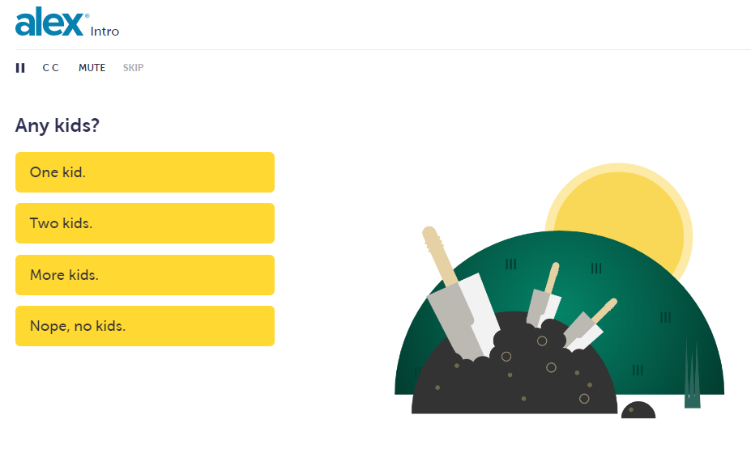
ALEX Makeover
The ALEX Benefits Counselor tool has been enhanced
More inclusive verbiage
Addresses care for out of state dependents
New modules describing legal plan and Aflac benefit plan coverage
ALEX Go streamlined for smartphones in English and Spanish

Slide 25
Flexible Spending Accounts
2023 Health Care FSA Contribution Limit $2,850
Health FSA carryover limit
$570 for carryover from 2022 to 2023 Plan Year
$570 for carryover from 2023 to 2024 Plan Year
2023 Dependent Care FSA Contribution Limit
$5,000 for non-highly compensated employees
$3,000 for Highly-Compensated Employees as defined by the IRS
$135K or greater income in 2022

Slide 26
Flexible Spending Accounts
Claims Submission Deadlines
2021 Plan Year DepCare FSA Grace Period Extension
Expenses must be incurred by December 31, 2022
Claims submission deadline January 31, 2023
2022 DepCare and Health FSA filing deadline: April 15, 2023
2023 DepCare and Health FSA filing deadline: April 15, 2024

Slide 27
NEW! Limited Purpose Flexible Spending Account
Available only to employees meeting all of the following criteria:
Eligible for the Faculty/Staff Benefits program, and
Participated in the Health FSA during a plan year, and
Has a carry-over balance greater than $25 at the end of that plan year, and
Enroll in the UC Health Savings Plan for the following plan year
LPFSA account will be created for eligible employee automatically - employee does not have to (cannot) elect to participate
Balance of the Health FSA that is eligible for carry-over – up to $570 - is placed in the LPFSA
Contributions are limited to the Health FSA balance - the participant may not contribute additional funds
Generally, eligible expenses are restricted to dental, vision and preventive care services
Participation is limited to one year.

Slide 28
2023 Dental and Vision Benefits
Delta Dental | VSP – Vision Plan Services
PPO plan offers new Cone Beam Imaging benefit paid at 100% for in network providers | No changes to benefits
Delta Care HMO – No changes to benefits

Slide 29
2023 Additional Benefit Offerings
ARAG Legal Plan | Adoption Assistance | Nationwide Pet Insurance | Aflac Supplemental Health Plans
Added for 2023 Estate planning Funding a trust Trust Dispute Secondary Residence Foreclosure Disputes Property Tax Zoning issues, and more No plan rate changes | Administered by WEX Health, provides financial support through reimbursement of up to $5,000 of eligible expenses per adoption. Limited to two adoptions | Individual policies purchased directly with vendor Open for enrollment year-round No changes to benefits | Accident, Critical Illness and Hospital Indemnity coverage Available for selection during Open Enrollment or a mid-year Qualifying Life Event on the UCPath portal. No plan design or rate changes

Slide 30
UCR Central HR Benefits Team
Tina Rodriguez, Benefits Manager
tina.rodriguez@ucr.edu
951.827.5086
Ranada Palmer, Health Care Facilitator/Benefits Lead
ranada.palmer@ucr.edu
951.827.2636

Slide 31
THANK YOU!
Please email any questions to benefits@ucr.edu

