Slide 1






Slide 2

New! ALEX Benefits
Counselor Tool

Slide 3
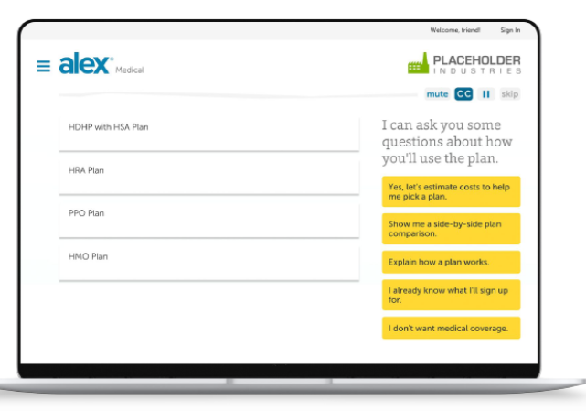
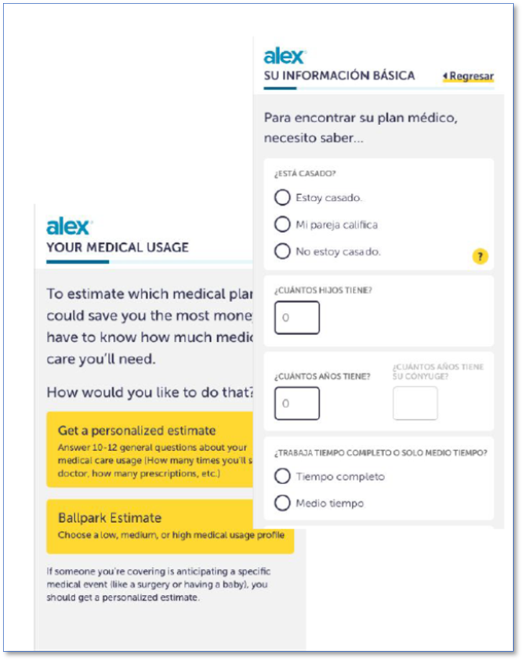

ALEX Benefits Counselor Tool
  ALEX Benefits Counselor: Our interactive benefits conversation available for new hires, qualifying life events and those going through Open Enrollment.
  An alternative, text-based Benefits Counselor experience that will be available in Spanish and English for Open Enrollment
  A way to provide employees more flexibility to find their best-fit options, at their own pace, in their own language, and on their preferred device (pc or mobile)
  Our interactive benefits conversation is available for new hires, qualifying life events, and Open Enrollment.
  ALEX will cover the following:
Medical Tax savings Dental Vision Life | Disability Accident Critical Illness EAP More benefits
  Other Benefits Faculty and Staff

Slide 4
2022 Medical Plans
Health & Welfare
Benefits

Slide 5
Medical Plans offered for 2022
  UC Blue & Gold HMO (Health Net)
  Kaiser Permanente HMO*
  UC Care (Anthem Blue Cross PPO)
  UC Health Savings Plan with Health Saving Account (HSA) (Anthem Blue Cross PPO)
  CORE (Anthem Blue Cross PPO)
*Optum is an additional behavioral health benefit option for Kaiser members

Slide 6
2022 HMO Medical Plans for
Faculty and Staff
UC Blue & Gold HMO
Kaiser HMO

Slide 7
UC Blue & Gold HMO
Plan Design Changes
  Split Fill Pharmacy Program
  Members can obtain a 2-week supply of high cost, high adverse effect medication at $0 copay to determine tolerance of high-cost therapy
  Applies only to oral anti-cancer medications in 2022 and may be expanded to other medications in future years
  Designed to prevent waste and allow opportunity to determine drug tolerance
  Medically necessary brand drugs will now have a lower copay
  Generic Drug Substitution Policy Change (Maximum Allowable Charges)
  Allows more options for brand name drugs at reduced rates

Slide 8
UC Blue & Gold HMO
Plan Design and Network Changes
  Flu Shots – Adults and Children
  Can be obtained at office visit or Health Net-contracted pharmacy at $0 copay and no upfront costs nor claims to file
  Other Adult Immunization
  Can be obtained at office visit or Health Net-contracted pharmacy at $0 copay and no upfront costs nor claims to file
  Does not apply to children’s vaccines
  Network Changes
  Sharp Rees-Stealy Medical Group in the San Diego area has reopened

Slide 9
Kaiser Permanente HMO
Plan Design Changes − Mandatory
  Dental Exams and Treatment − Retroactive Change January 1, 2021
  Medically necessary dental exams/treatment prior to any organ transplant now covered (previously only covered prior to kidney transplants)
  House Calls Cost Share Alignment
  In-home medical visits from a PCP or specialist will change from $0 copay to now align with the cost share based on the visit type

Slide 10
2022 PPO Medical Plans
for Faculty and Staff
UC Care
UC Health Savings Plan
CORE

Slide 11
Plan & Program Changes
UC PPO plans (Anthem Blue Cross)
  Navitus replaces Anthem IngenioRx as Pharmacy Benefit Manager
  Pre-enrollment website available now
  Drug Look-up, Pharmacy Search, Drug Cost Preview Tool
  Any member affected by medication changes will be notified
  24/7 Customer Care open now
  Member Portals available starting January 1, 2022
  Pharmacy Network
  Retail pharmacies ‒ including participating UC pharmacies
  Mail Order through Costco
  Specialty Rx through Lumicera and participating UC Specialty pharmacies
  Learn to Live replaces myStrength Wellness App

Slide 12
UC Health Savings Plan
HSA Contribution Change
  Maximum Health Savings Accounts (HSA) Contribution for the Year
  Single Coverage - $3,650 (from $3,600)
  Family Coverage - $7,300 (from $7,200)
  Same Catch up contribution for those 55 years old and over: $1,000
  Same UC contribution towards the HSP member’s HSA
  One time contribution based on January 1 coverage level
  $ 500 for single coverage for a year
  $1,000 for family coverage for a year

Slide 13
Member ID Cards for 2022
Anthem Blue Cross plans
UC Care, CORE | 1 ID card only from Anthem for medical and Rx (all members)
UC Health Savings Plan | 1 ID card only from Anthem for medical and Rx (all members) HSA debit card to new members and to current members whose cards are expiring (card is good for 3 years from issue date)
Kaiser Permanente HMO | 1 ID card to new members only
UC Blue & Gold HMO (Health Net) | 1 ID card to all members, new and current

Slide 14
2022 Pay Bands, Rates and Contributions

Slide 15
2022 Employee Contributions
Union member exact rates see Systemwide Bargaining Units
2022 |  | Pay Band 1 |  |  |  |  | Pay Band 2
Contributions |  | ($61,000 and Under) |  |  |  | ($61,001 to $120,000)
 | EE | EE+C | EE+Sp | EE+Fam |  | EE | EE+C | EE+Sp | EE+Fam
UC B&G HMO | $69.05 | $124.29 | $211.15 | $266.39 |  | $107.23 | $193.01 | $298.31 | $384.10
Kaiser HMO | $26.94 | $48.49 | $59.00 | $80.51 |  | $65.12 | $117.21 | $146.16 | $198.22
HSP | $23.69 | $42.65 | $51.89 | $70.81 |  | $61.87 | $111.37 | $139.05 | $188.52
UC Care | $141.74 | $255.13 | $358.26 | $471.65 |  | $179.92 | $323.85 | $445.42 | $589.36
UC Medicare PPO, UC High Option Supplement, Kaiser Senior Advantage, UC Medicare Choice
Plan Feature
2022 |  | Pay Band 3 |  |  |  |  | Pay Band 4
Contributions |  | ($120,001 to $180,000) |  |  |  |  | (Over $180,000)
 | EE | EE+C | EE+Sp | EE+Fam |  | EE | EE+C | EE+Sp | EE+Fam
UC B&G HMO | $146.41 | $236.53 | $376.42 | $493.55 |  | $186.98 | $336.56 | $457.35 | $606.93
Kaiser HMO | $104.30 | $187.73 | $224.27 | $307.67 |  | $144.87 | $260.76 | $305.20 | $421.05
 |  |  |  |  |  | $141.62 | $254.92 | $298.09 | $411.35
HSP | $101.05 | $181.89 | $217.16 | $297.97
UC Care | $219.10 | $394.37 | $523.53 | $698.81 |  | $259.67 | $467.40 | $604.46 | $812.19
$0 Employee Premium Contribution for the CORE Plan

Slide 16
Non-Medical Benefit Updates

Slide 17
Dental and Vision Coverage
Dental
Vision
VSP continues as the vision vendor
  Delta Dental continues as the dental provider
  There are no benefit changes for either the PPO or DHMO Plans
  Benefit enhancements:
    Contact Lens Allowance increasing from $110 to $160
  Primary Eyecare Program becomes permanent
  Provides supplemental medical eye care services, including: eye injury/trauma, foreign body removal, diagnosis and treatment of eye conditions including pink eye, vision loss and cataracts

Slide 18
Supplemental Health Plans
  Aflac continues as the vendor for Accident, Critical Illness and Hospital Indemnity Insurance
  New coverage for Human Coronavirus in the Critical Illness Plan
Plan Coverage Level | $10,000 | $30,000
Hospitalized 4-9 days Pays 10% of coverage level | $1,000 | $3,000
Hospitalized 10+ days Pays 25% of coverage level | $2,500 | $7,500
  No benefit changes in the Accident or Hospital Indemnity Plans
  No rate changes for any of the three plans for 2022

Slide 19
Legal
  ARAG continues as the Legal Insurance provider
  Benefit Enhancements:
    Alimony and Child Support Modifications
    Child Support Enforcement
    Annual Accounting - Guardianship/Conservatorship
    Restraining Orders
    General Support Hours increasing from 4 to 6 per year
  No rate changes for 2022

Slide 20
Pet Insurance and Family Care
  Pet Insurance
    Nationwide continues as the vendor
    Individual policies are purchased directly with the vendor
  Family Care
    Bright Horizons continues as the vendor
    Program provides referral services only

Slide 21
Flexible Spending Accounts (FSAs)
    2022 FSA Contribution Limits
      Health Care FSA $ 2,750
      Dependent Care FSA $ 5,000
    DepCare contribution limit increase to $10,500 was for plan year 2021 only
    Until further notice, participants cannot make an election change in 2022 without a life event
    Annual re-enrollment and selecting new contribution amount is required to continue participation in the FSA and Dependent Care plans in 2022

Slide 22
Flexible Spending Accounts (FSAs)
  Health FSA
    Entire unused balance from 2020 and 2021 will be carried over to 2022 and be available first week of January 2022
    Claims submission deadline for expenses incurred in 2021: April 15, 2022
  DepCare FSA
    2020 grace period extension ends December 31, 2021
      Any 2020 unused balance can be used to reimburse claims incurred during plan years 2020 or 2021
      All claims using 2020 contributions must be filed by January 31, 2022
    2021 grace period extension ends December 31, 2022
      Any 2021 unused balance can be used to reimburse claims incurred during plan years 2021 or 2022
      All claims using 2021 contributions must be filed by January 31, 2023

Slide 23
Helpful Open Enrollment Website Links
ALEX tool website link: https://www.myalex.com/uc/2022#intro
How to Complete Open Enrollment in UCPath
  https://ucnet.universityofcalifornia.edu/oe/how-to-enroll/faculty-staff/index.html
  Open Enrollment Benefits Course (hosted by UCPath)
Postdoctoral Scholars Benefits webinars
  https://hr.uci.edu/partnership/oe/files/UC-PSBP-OE-Webinar-Flyer-2022.pdf
Postdoctoral Scholars Open Enrollment information website
  https://clients.garnett-powers.com/pd/uc/

Slide 24
UCR Central HR Benefits Team
  Tina Rodriguez, Benefits Lead
    Tina.rodriguez@ucr.edu
    951.827.5086
  Ranada Palmer, Health Care Facilitator
    ranada.palmer@ucr.edu
    951.827.2636

Slide 25
Questions?

