Slide 1
Pre-Retirement Planning Workshop
Benefits Office

Slide 2
Pre-Retirement Planning Topics
Forecast your best date for retirement
Estimate your retirement benefits at different age scenarios (income planning)
Estimate and review eligibility for continuing retiree health benefits
Navigating through the Retirement Administration Service Center (RASC)
Coordinating a one-on-one financial planning meeting with Fidelity Investments
The UC Medicare coordination process
Benefits of the Health Care Facilitator Program
Review the benefits of joining and information about the Emeriti/Retirees’ Association

Slide 3
Pre-Retirement Information and Resources
Pre-Retirement Information and Resources website
Retiree Health premium estimator
Pre-Retirement Information and Resources Checklist
Retirement At Your Service (UCRAYS) website
Beneficiary information
Contact information
Retiree health benefits
Monthly retirement statements
Income
Taxes
Benefits premiums

Slide 4
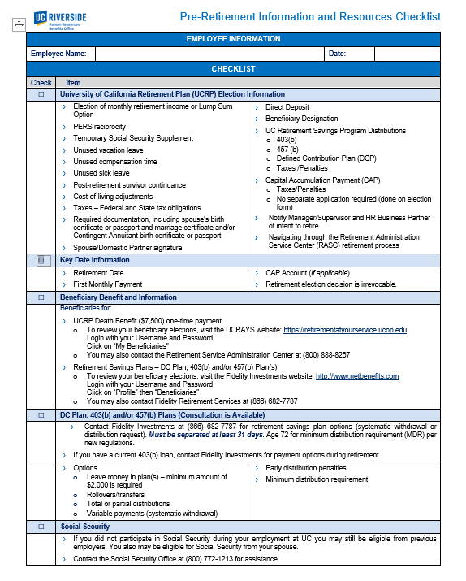
Pre-Retirement Information and Resources Checklist

Slide 5
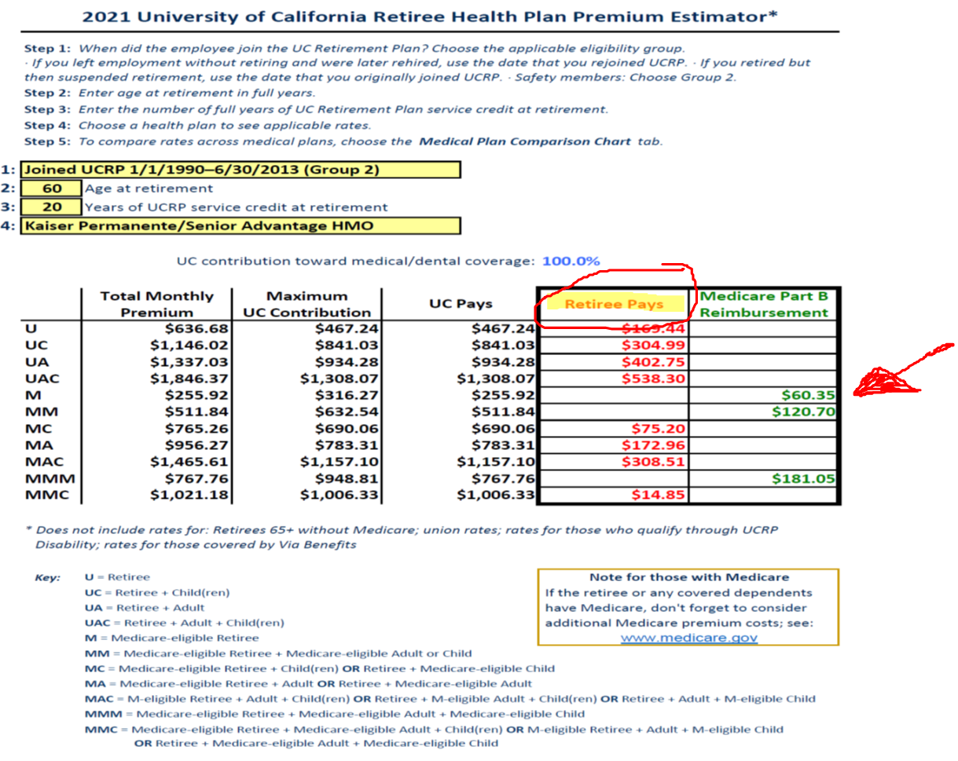
Retirement Health Premium Estimator

Slide 6
Medicare Coordination
The Human Resources Benefits Office assists retirees and emeriti with the coordination of Medicare benefits
If you are still working and reach age 65, you may defer enrollment in Medicare Part B until you retire and will not be subject to the 10% penalty
Once you retire and reach age 65, in order to maintain your UC retiree health benefits, you and/or your spouse/domestic partner are required to enroll in Medicare Part A and B only
Failure to enroll in Medicare Part A and B will result in a UC penalty for non-compliance and cancellation of retiree health benefits

Slide 7
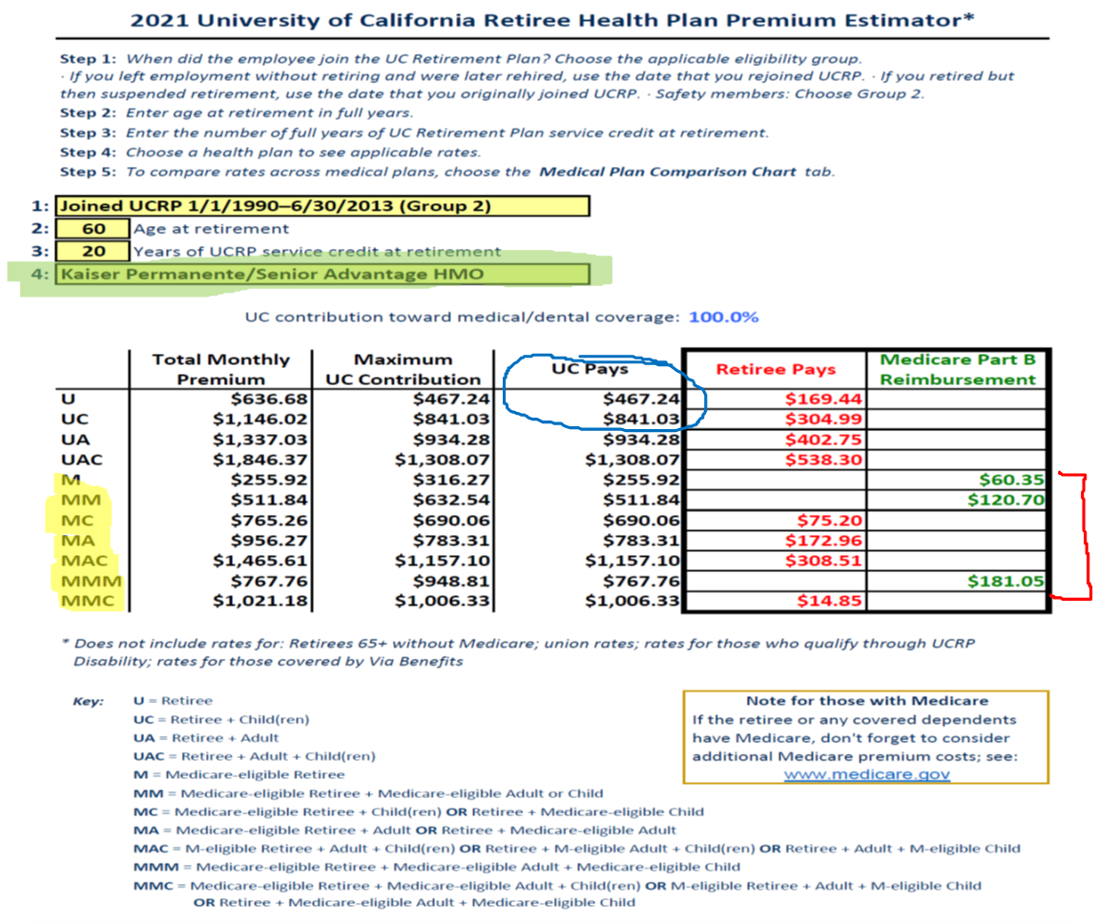
Medicare Coordination
Notes:
Show Medicare premium estimator to give example of cost reduction

Slide 8
Health Care Facilitator Program
The Health Care Facilitator (HCF) provides assistance for faculty, staff, retirees, survivors and their eligible family members regarding benefits and services available from the UC-sponsored health plans
The HCF assists with resolving issues related to UC medical (doctors, medical groups or providers), dental and vision plans
The HCF is a knowledgeable counselor who delivers confidential one-on-one assistance

Slide 9
Services Available
The Health Care Facilitator may assist with:
Understanding the UC health plan coverage and patient rights
Defining health care issues
Navigating the health care system
Resolving issues with billing, doctors, medical groups or medical plan carriers
Understanding how Medicare benefits coordinate with UC-sponsored medical plans

Slide 10
Services Not Provided
The Health Care Facilitator does not:
Provide medical or legal advice
Act as a patient care advocate for services/benefits that are not offered by UC’s plans
Suggest treatment plans

Slide 11
Contacts
Ranada Palmer, Health Care Facilitator Phone: (951) 827-2636 Email: ranada.palmer@ucr.edu
Tina Rodriguez, Benefits Lead Phone: (951) 827-5086 Email: tina.rodriguez@ucr.edu

Slide 12
THANK YOU!

