Slide 1


FOR EMPLOYEES
NOT ELIGIBLE FOR
PRIMARY RETIREMENT BENEFITS
v.121521
Notes:
Good afternoon everyone. Welcome to today’s new employee benefits orientation.
I am _______ and I will be leading you through this webinar, along with my colleague______ . This orientation is specifically designed for employees who are not eligible for the UC Primary Retirement Benefits program. You may hear yourself referred to as a “Safe Harbor” participant. Safe Harbor employees include part-time, seasonal and temporary UC employees who are not eligible to participate in the Primary Retirement Benefits Program and whose pay is not subject to Social Security taxes. Also included in this category are non-exempt UC student employees who do not satisfy certain course load requirements, and certain resident aliens and academic appointees.
Depending on your status, you may be eligible for the mid or core level health & welfare benefits package. However, some Safe Harbor employees who do not meet minimum work requirements are not eligible for any health & welfare benefits. But, all of you (except students who normally work less than 20 hrs/wk) participate in the Retirement Savings Program.
Today’s presentation will last about one and a half hours, including Q&As towards the end of the presentation.
A quick housekeeping note: We’ll be placing everyone on mute to reduce background noise. We’ll unmute the lines after each section, so that you can ask questions.
OK, let’s get started with a quick introduction to the University of California.

Slide 2

2
Notes:
Working at UC means being part of the world’s leading public research university with almost 200,000 employees, making us one of the largest employers in California.
We know that it’s our people who make UC great -- every faculty and staff member plays an important role in the UC community.
That’s why we work hard to be a good employer and to make UC a place where people enjoy what they do and feel rewarded for their contributions.
We offer outstanding health and retirement benefits for you and your family, opportunities to advance your career, and the chance to make a difference alongside some of the brightest, most visionary thinkers of our time.

Slide 3
3
3
INTRODUCTION NEW EMPLOYEE BENEFITS ORIENTATION
What we’ll cover today
UC Benefit Programs
Eligibility
Enrollment deadlines
How to enroll
Additional resources
Notes:
Today we will provide an overview of the UC benefits program – a description of each benefit, how it works, who is eligible for coverage, and when and how to enroll.
But it’s just a summary. We recognize that each person has different benefits needs and priorities, so we have developed a comprehensive set of resources to get details on what matters to YOU.

Slide 4


4
4
INTRODUCTION NEW EMPLOYEE BENEFITS ORIENTATION
Welcome Kit
Notes:
If you haven’t received your Welcome Kit, you should contact the UCPATH Center.
Please spend some time reviewing the contents and visiting UCnet – the website dedicated to topics related to working at UC.
It will be very helpful to have your Welcome Kit in front of you as we go through today’s presentation, since we will be referencing the materials often.

Slide 5
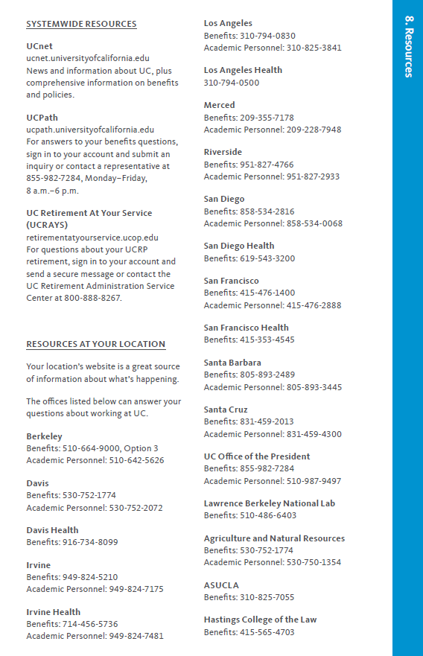
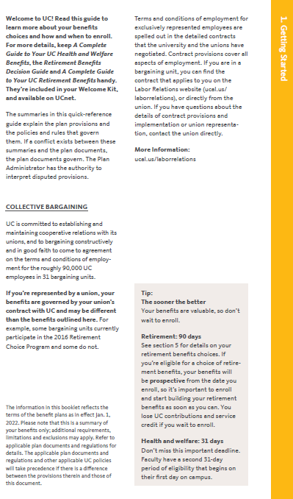

5
5
5
INTRODUCTION NEW EMPLOYEE BENEFITS ORIENTATION
Notes:
We recommend that you start with the small “Your benefits at a glance” piece, which provides a good overview of what we’re covering here today and contacts at each location.

Slide 6

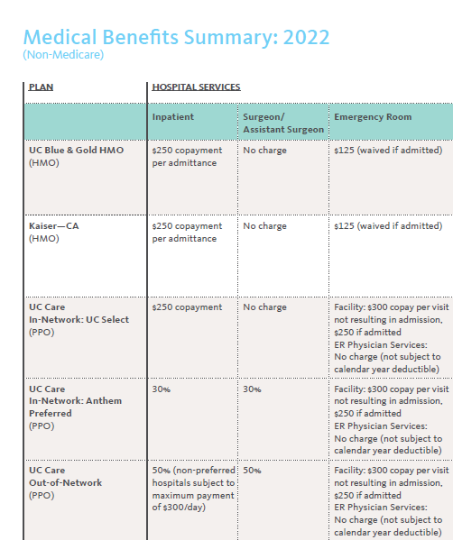
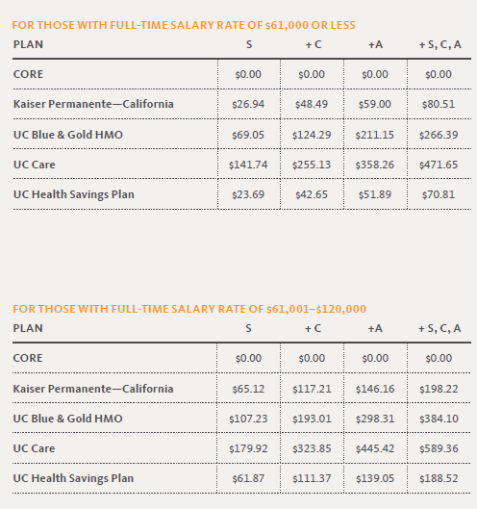
6
6
6
INTRODUCTION NEW EMPLOYEE BENEFITS ORIENTATION
Notes:
The small “Which medical plan is right for you” booklet has the plan costs based on salary level and a summary chart that compares key features among the plans. This booklet can be found online on UCnet.

Slide 7

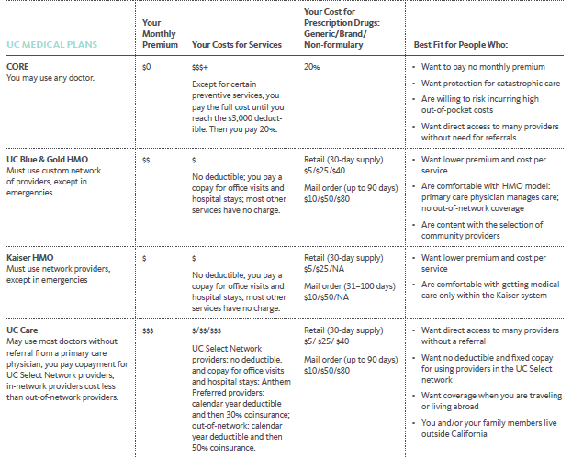
7
7
7
INTRODUCTION NEW EMPLOYEE BENEFITS ORIENTATION
Notes:
The “Complete Guide to Your UC Health Benefits” booklet also includes a plan comparison with a summary of costs and who each plan may best suit.

Slide 8
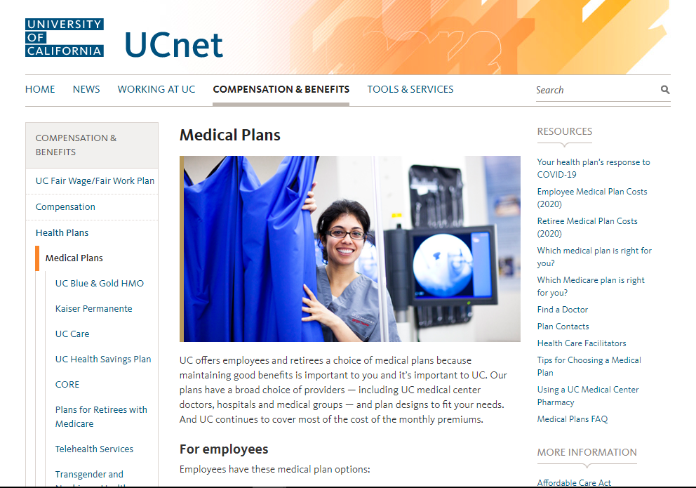

8
8
8
INTRODUCTION NEW EMPLOYEE BENEFITS ORIENTATION
Notes:
Aside from the Welcome Kit, UCnet is your best source of information about our benefits. For health benefits, it has videos to help you compare plans, a glossary to help you understand insurance terms, and has additional resources like links to each plan so that you can search the provider network or call their member services team with questions about coverage.
(Click)
Each location has a health care facilitator who can assist with questions about local medical plans, claims or access issues that you may have when using a plan. Their brochure is on UCnet.

Slide 9


9
9
INTRODUCTION NEW EMPLOYEE BENEFITS ORIENTATION
ALEX – Benefits Decision Support Tool
A fun, interactive benefits conversation for faculty and staff
Provides guidance on best-fit plans based on medical care needs, cost, provider access preferences and other factors
Includes:
  Medical
  Supplemental Health Plans
  Tax savings options (FSA & HSA)
  Disability, Life and Accident Insurance
  Other Voluntary Benefits – Legal, Pet, Homeowners, Auto
myalex.com/uc/2022
Notes:
What’s your Open Enrollment strategy?
Pick the plan with the lowest monthly premium? Stick with the carrier you’ve always had?
If you’re ready to try a new approach to choosing your benefits, ALEX is here to help.
ALEX is a fun and friendly guide who gets to know you, so you get just the information you need.
You can even try out different scenarios (a lot of medical care or a little, covering your whole family or just yourself) to help you understand all of your options.

Slide 10
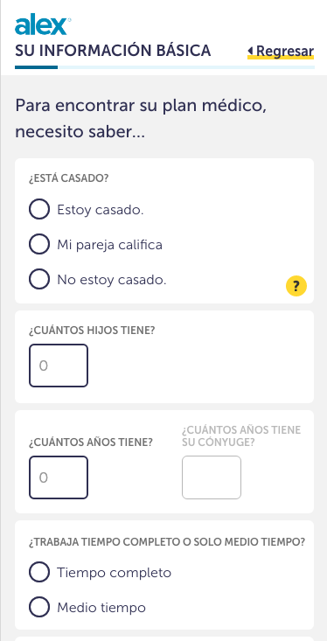
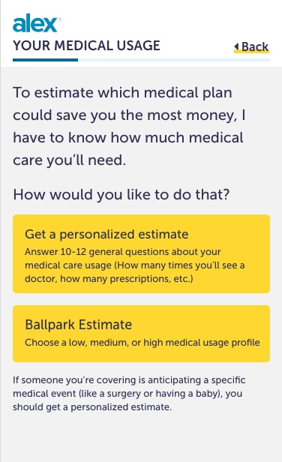
10
INTRODUCTION NEW EMPLOYEE BENEFITS ORIENTATION
ALEX – Benefits Decision Support Tool
ALEX Go
Alternative text-based version of ALEX optimized for smartphones and other mobile devices
Available in English:
  https://go.myalex.com/uc/2022
Available in Spanish:
https://go.myalex.com/es/uc/2022
Notes:
Think of ALEX as your own personal benefits counselor — available 24/7 on your computer, phone or tablet.
For the same great coaching in Spanish, check out ALEX Go. Just click on the Spanish language link on the ALEX launch screen or go to the link provided: https://go.myalex.com/es/uc/2022

Slide 11
11
11
11
INTRODUCTION NEW EMPLOYEE BENEFITS ORIENTATION
Benefits Eligibility - Health & Welfare
Appointment Type | Mid-Level | CORE
Academic, limited, partial-year career, contract, floater | work 100% for at least 3 months for less than one year; OR at least 50% for a year or more but in a position that is not eligible for UCRP | work in an eligible position at least 43.75% time
Per diem, casual/restricted (students), by agreement or seasonal | N/A | work at least 75% for at least 3 months
Continuing eligibility threshold = 30 hours/week
Continuing eligibility threshold = 17.5 hours/week
Notes:
UC offers two health & welfare benefits packages to Safe Harbor employees: Mid-level and CORE. If you are not in either group, you do not receive any health & welfare benefits.
Your eligibility for a particular benefits package depends on the type of job you have, the percentage of time you work and the length of your appointment.
Your offer letter should indicate which benefits package you are eligible for, however here are the initial requirements:
(read the boxes).
UC bases your ongoing eligibility for benefits on your average hours of service over a 12-month period from approximately Nov to Nov. (Click)
Once you earn benefits eligibility, you’ll continue those benefits as long as you meet a certain threshold, which is shown in the orange boxes.

Slide 12
12
12
INTRODUCTION NEW EMPLOYEE BENEFITS ORIENTATION
Must enroll within 31 days
Benefits Eligibility - Health & Welfare
 | Mid-Level | CORE
Medical – All Options | ✓
Medical – CORE Plan only * | ✓ | ✓
Basic Short-term Disability * | ✓ | ✓
Voluntary Short-term Disability | ✓ | ✓
Voluntary Long-term Disability | ✓ | ✓
CORE Life - $5,000 * | ✓ | ✓
Supplemental Life | ✓
Dependent Life | ✓
Accidental Death & Dismemberment | ✓ | ✓
Business Travel Accident * | ✓ | ✓
Legal | ✓ | ✓
Pet Insurance | ✓ | ✓
Auto and Homeowner/Renter | ✓
Family Care | ✓ | ✓
Flexible Spending Accounts | ✓ | ✓
Accident | ✓ | ✓
Critical Illness | ✓ | ✓
Hospital Indemnity | ✓ | ✓
*Provided at no cost to you
Notes:
UC provides some plans at no cost to mid-level and CORE eligible employees.
You’re enrolled automatically in basic short term disability, CORE life, business travel accident insurance.
And for others, including medical, you must enroll within 31 days of your hire date. (Click)
We’ll cover all of these benefits in more detail today.

Slide 13
13
13
INTRODUCTION NEW EMPLOYEE BENEFITS ORIENTATION
Benefits Eligibility - Retirement Savings Program (RSP)
 | Mandatory | Optional
Defined Contribution Plan (DCP) Pre-tax - 7.5% employee contribution | ✓
Pre-tax 403(b) Pre-tax 457(b) DCP After-tax |  | ✓
Notes:
Safe Harbor employees are not eligible to participate in the UC Retirement Plan and instead make mandatory contributions of 7.5% to the DC Plan Pre-tax account. This contribution is in lieu of the Social Security tax.

Slide 14
14
14
INTRODUCTION NEW EMPLOYEE BENEFITS ORIENTATION
Represented Employees
Terms of your benefits are subject to collective bargaining
Your benefits may be different
ucal.us/agreements
Notes:
Some university positions are represented by unions, and their benefits are subject to collective bargaining.
So if you’re in a union, your benefits may be different from what we describe today. You can check your bargaining agreement—which is posted on UCnet—or talk to your union representative for details. Your recruiter or hiring department can tell you whether your position is subject to a UC union contract.

Slide 15

15
15
FOR MID-LEVEL AND CORE PACKAGES
ucnet.universityofcalifornia.edu
Notes:
Let’s begin with medical benefits, which are only available to mid-level and CORE eligible employees. Remember that if you are not in either group, you do not receive any health & welfare benefits.

Slide 16
16
MEDICAL PLANS NEW EMPLOYEE BENEFITS ORIENTATION
Benefits Eligibility - Medical
 | Mid-Level | CORE
All Options | ✓
CORE Plan only * | ✓ | ✓
*Provided at no cost to you
Notes:
Mid-level benefits packages include all of the medical plan options. The CORE package includes only the CORE medical plan, whose premium is paid by UC.

Slide 17
17
MEDICAL PLANS NEW EMPLOYEE BENEFITS ORIENTATION
What they have in common
No exclusions for pre-existing conditions
Prescription drug coverage
Behavioral health coverage
High quality providers
In-network preventive care at no cost
Out-of-pocket maximums
Notes:
While all of our plans vary in important ways, they all have some key elements in common.
There are no exclusions for pre-existing conditions.
All of our plans have prescription drug coverage,
behavioral health coverage
and high-quality providers.
We keep health care affordable to you by offering free preventive care.
and through annual out-of-pocket maximums.
Annual out-of-pocket maximums limit what you pay for covered services. If you reach this max, the plan pays 100% of the allowed amount for covered medical and prescription drug costs for the remainder of the year.

Slide 18
18
18
MEDICAL PLANS NEW EMPLOYEE BENEFITS ORIENTATION
Medical Plan Options
HMO
PPO
UC Blue & Gold (administered by Health Net)
Kaiser Permanente
Not available in Merced or Santa Barbara counties
UC Care
UC Health Savings Plan
CORE
Only plan offered to CORE-eligible employees
Notes:
UC offers 2 different types of medical plans. Health Maintenance Organizations (HMOs) – are designed to service specific geographic areas which means some UC locations will not have access to all HMO plans. If you want to know whether your zipcode is in a plan’s service area, check the plan’s website or call directly. (Click)
UC also offers Preferred Provider Organizations (PPOs) with wider provider access, including outside of CA and the U.S. This is important for people who want to cover dependents living outside of CA or spend a lot of time internationally. (Click)

Slide 19
19
19
MEDICAL PLANS NEW EMPLOYEE BENEFITS ORIENTATION
HMO vs. PPO – key considerations
HMO PPO
Provider choice | Must stay in network HMO network typically smaller than PPO network CA only | Can receive care in or out-of-network Out-of-network services covered at lower level U.S. and international
Member out-of-pocket cost | Fixed copay; no deductibles | Percent of charges (coinsurance); often after deductible
Referral process | Specialist referrals must be made by primary care physician | Can self-refer to specialist
*Where you live affects the health plans available for enrollment. UC’s HMO plans, Kaiser and UC Blue & Gold, are not available in some regions in California, nor outside the state. Talk to your local Benefits Office about your options before you enroll and if you plan to move.
Notes:
When deciding between an HMO and PPO, it’s important to understand some key differences. (Click)
With HMOs, you get services from a custom network of doctors, hospitals and other providers. Also, HMOs may have a smaller network than PPOs and the service area is limited to California.
And generally, HMOs have a lower monthly premium and lower out-of-pocket costs than PPOs. Your costs are predictable: You don’t have deductibles; instead there are small co-pays for office visits and some services have no charge. HMOs contain costs by managing care through a primary care physician; that means you need a referral from your primary care doctor to see most specialists. (Click)
Where you live affects the health plans in which you may enroll. UC’s HMO plans, Kaiser and UC Blue & Gold, are not available in some regions in California, nor outside the state. Talk to your local Benefits Office about your options before you enroll and if you plan to move. If you move out of a plan service area, or will be away for more than two months, you and your eligible family members must transfer into a different plan available in your new location.
Under a PPO plan, you have more choice. You can see providers who are in or out of a preferred network. However, you will pay much less for an in-network provider because they have discounted their rates and the plan covers a larger portion of the costs. There are network providers outside of CA and the United States.
You generally pay a percentage of the cost of services (called “coinsurance”), often after an upfront deductible. Each time you use medical services, you can choose an in-network or out-of-network provider.
If you are unfamiliar with how deductibles, coinsurance and out of pocket maximums work together, check out the Glossary of Terms on UCnet.

Slide 20
20
20
MEDICAL PLANS NEW EMPLOYEE BENEFITS ORIENTATION
Kaiser and UC Blue & Gold HMOs
In-network coverage only, except in emergencies
Review the directory; no network access outside of CA
PCP coordinates your care and makes referrals
UC Blue & Gold provider ID# requested during enrollment process
Pay fixed copay for Rx and other services
Notes:
Here are a few things to know about the HMOs that UC offers
Except in emergencies, you must use the providers in the plan’s network –
-For the Kaiser plan: you can only go to Kaiser providers and facilities. The Kaiser service area is not available in Merced and Santa Barbara counties.
-For UC Blue & Gold: you can only go to the Health Net Blue & Gold contracted providers. This network was created specifically for UC and includes all UC medical centers.
We know that there are certain medical facilities or doctors that are important to you - so be sure your providers are in the plan before you enroll by using the provider search tools on UCnet. Note that for the two HMOs, there is no network access outside of California.
Because your primary care physician plays such an important role in a HMO, you will need to enter your PCP’s provider ID number during the enrollment process for Health Net. If you do not, you will automatically be assigned a PCP. You can change it later, but it will be easier if you go on the plan’s website and get the provider ID before you enroll.
When you receive services, you pay only a fixed copay. This applies to prescriptions too.

Slide 21
21
21
MEDICAL PLANS NEW EMPLOYEE BENEFITS ORIENTATION
UC Care PPO
In-network
UC Select network: Customized network of UC facilities and other high-quality, lower-cost providers
Anthem Preferred network
Blue Cross Blue Shield Global Core network outside of CA and the U.S.
Rx through Navitus
Out-of-network
Notes:
Now let’s take a closer look at the PPO options that UC offers.
UC Care is a PPO, designed specifically for UC, that allows you to use the services of any doctor or hospital. While the plan does not require a referral to see a specialist there may be some specialists who will want one from your primary care physician.
The amount you pay will depend on the provider tier.
There are three provider tier options for in-network benefits.
Tier 1 is the UC Select network. Tier 2 is the Anthem Preferred network. Tier 3 is the Out-of-Network providers. Let us go over each of these.
In January 2022, Navitus became the Pharmacy Benefit Manager for the prescription drug plan.
The UC Select Network includes UC medical center providers and facilities, as well as other select Anthem Blue Cross providers in areas where UC medical centers and physicians may not be accessible. You pay a copayment for office visits and certain services when you use Select Network providers. UC Select is only available in California.
Anthem Preferred Network: You pay 30 percent co-insurance after you meet the plan deductible.
There’s even a network available if you’re living or traveling outside of California and the United States called Blue Cross Blue Shield Global Core Network. You usually pay 30 percent co-insurance after you meet the deductible.
You can find the link to the providers in the UC Select and Anthem Preferred networks on the ucppoplans.com website.
You also have the option to see an out of network provider, but you’ll pay a larger portion of the cost. Each time you use medical services you can choose in-network or out-of-network providers.

Slide 22
22
22
MEDICAL PLANS NEW EMPLOYEE BENEFITS ORIENTATION
UC Care PPO
 | UC SELECT | ANTHEM PREFERRED | OUT-OF-NETWORK
Calendar-year deductible | No deductible | $500 Single $1,000 Family | $750 Single $1,750 Family
Physician office visit, including specialists | $20 copay | 30% coinsurance after deductible | 50% coinsurance after deductible*
Outpatient surgery in hospital | $100 copay | 30% coinsurance after deductible | 50% coinsurance after deductible*
Inpatient Non-emergency facility services | $250 copay per admission | 30% coinsurance after deductible | 50% coinsurance after deductible*
Out-of-pocket maximum (medical, behavioral health and pharmacy | $6,100 Single $9,700 Family | $7,600 Single $14,200 Family | $9,600 Single $20,200 Family
*Plan pays 50% of allowable charges and member responsible for remaining balance
Notes:
This chart shows your share of the cost for different services, depending on the network of the provider you see. (Click)
You pay the least if you see providers in the UC Select Network.
If you stay within the UC Select Network you do not have a deductible, and only pay a $20 copayment for office visits, and $250 copayment for hospital stays. (Click)
With Anthem Preferred, you have a low deductible. For covered services, UC Care pays 70 percent and you pay 30 percent through coinsurance, once you have met your deductible.
Once you meet the out-of-pocket maximum—the most you pay annually—the plan pays 100 percent of the Anthem allowed amount for the remainder of the calendar year.
If you go to an out-of-network provider, your deductible is higher. Once you have met your deductible, UC Care pays 50 percent of the allowable charges and you pay the remaining amount.
More detailed information is available on the UC Care website.

Slide 23
23
23
MEDICAL PLANS NEW EMPLOYEE BENEFITS ORIENTATION
UC Health Savings Plan
Combines a higher-deductible PPO with a health savings account to pay out-of-pocket expenses
Medical Coverage: Anthem PPO
Rx through Navitus
Health Savings Account: HealthEquity
In-network coverage
Anthem Preferred network
Blue Cross Blue Shield Global Core network outside of CA and U.S.
Out-of-network coverage
Notes:
Another PPO option is the UC Health Savings Plan or HSP.
The HSP is a higher-deductible PPO paired with a health savings account that provides triple tax advantages. The medical plan is administered by Anthem Blue Cross and HealthEquity is the custodian of the savings account. Starting in January 2022, Navitus became the Pharmacy Benefit Manager for the prescription drug plan.
UC contributes to the HSA, and you can, too. Then, you use the health savings account to pay for eligible health expenses including your deductible.
You can choose any doctor or hospital you wish, but providers in the Anthem Preferred PPO network cost less.
Preventive care from in-network providers is covered at 100 percent without the need to meet your deductible.

Slide 24
24
24
MEDICAL PLANS NEW EMPLOYEE BENEFITS ORIENTATION
UC Health Savings Plan
NO MEDICARE/HEALTH FSA
 | IN-NETWORK | OUT-OF-NETWORK
Deductible - Single - Family | $1,400 $2,800 | $2,550 $5,100
Member pays (coinsurance after deductible is met) | 20% | 40%
Out-of-pocket maximum - Single - Family (includes deductible) | $4,000 $6,400 | $8,000 $16,000
Notes:
For all other services and prescriptions, you pay 100 percent of the cost, until you meet the deductibles shown here. Both medical and prescription drug charges apply to the deductible. (Click)
Once you meet the deductible, you pay coinsurance. (Click)
Remember, that out-of-pocket maximums limit what you pay for covered services in any year. If you reach the annual maximum, the plan pays 100 percent of your covered allowable medical and prescription drug costs for the rest of the year. (Click)
Please note that if you or a covered family member are enrolled in Medicare, you cannot enroll in this plan.
Also, because this plan has a health savings account from which you can pay expenses, you cannot enroll in the Health Flexible Spending Account.

Slide 25
25
25
MEDICAL PLANS NEW EMPLOYEE BENEFITS ORIENTATION
Health Savings Account (HSA) to pay expenses
Pro-rated in first year if HSP coverage becomes effective after Jan 31
CONTRIBUTION TYPES | INDIVIDUAL | FAMILY
UC Contribution | $500 | $1,000
Employee Pre-tax (optional) | up to $3,600 | up to $7,200
No use-it or lose it feature (Use it/ Save it / Invest it)
You own the account
Triple tax advantage
healthequity.com/ed/uc
Notes:
The Health Savings Account (HSA), lets you pay for your out-of-pocket health care expenses with tax-free dollars. You can use the funds at any time for qualified medical expenses or save them for future health care needs.
When you use health care services, you can pay directly with your HSA debit card or through the Health Equity website.
UC contributes to the HSA (up to $500 for individual coverage/$1,000 for family). If you change coverage levels during the calendar year, UC's contribution will not change until the next year.
If your coverage in the UC Health Savings Plan start anytime after January, the amount that UC contributes to your HSA will be prorated for the calendar year according to a schedule available on UCnet. (Click)
However, the plan deductible is not prorated. If you continue the plan the following year, you will receive the full UC contribution amount beginning January 1. (Click)
YOU also can contribute, with pre-tax payroll deductions, subject to payroll deadlines. HSA contributions for the year are subject to IRS limits; this includes your personal contributions as well as UCs contributions. Note that individuals age 55 and older can make an additional "catch-up" contribution of $1,000.
Unlike a flexible spending account, which we will cover later, your HSA has no “use-it-or-lose-it” feature, so your account balance rolls over annually and continues to grow tax-free.
You own the account, so the money goes with you if you leave UC. You can continue to contribute to it as long as you are enrolled in a qualified high-deductible health plan — even into retirement.
The HSA has a triple tax advantage: Your contributions, interest or investment earnings, and withdrawals are not subject to Federal taxes. Note that CA state taxes are not reduced.

Slide 26
26
26
MEDICAL PLANS NEW EMPLOYEE BENEFITS ORIENTATION
No premium - must enroll to be covered
CORE PPO
Higher deductible plan
$3,000 per person per year deductible
Medical and prescription drug charges apply to deductible
$6,350/individual or $12,700/family out-of-pocket annual maximum
Pay majority of benefits paid at 20% after meeting deductible
In-network preventive care covered at no charge
Rx through Navitus
Notes:
UC also offers a PPO plan at no cost to employees, but you must enroll to be covered. The CORE plan is a higher deductible plan, which means that you have to pay more out of pocket than in other UC plans, before insurance begins to cover part of the cost.
The deductible for the CORE plan is $3,000 per person per year. Both medical and prescription drug charges apply to the deductible.
And the plan’s out-of-pocket maximum is $6,350. You may balance the fact that there is no premium against the higher deductible and out-of-pocket maximum, but please consider whether you will be able to afford these amounts in the event you require expensive medical services.
Once you meet the deductible, in most cases you pay 20% of the contracted cost.
In-network preventive care is covered at no charge.
In January 2022, Navitus became the Pharmacy Benefit Manager for the prescription drug benefit.

Slide 27
27
27
MEDICAL PLANS NEW EMPLOYEE BENEFITS ORIENTATION
Behavioral Health
Mental health/substance abuse benefits provider depends on medical plan
UC BLUE & GOLD: Must use MHN network providers
KAISER: Can choose between Kaiser or Optum network providers
CORE, HEALTH SAVINGS PLAN, UC CARE: Can use Anthem network providers or non-network providers at a lower coverage level
Notes:
Your mental health/substance abuse benefits provider depends on the medical plan you choose.
UC BLUE & GOLD members must use MHN (Managed Health Network) providers, which members can find by going to the healthnet.com/uc website
KAISER members can choose between Kaiser or Optum in-network providers. Again, because Kaiser is an HMO, out of network providers are not covered.
CORE, HEALTH SAVINGS PLAN, UC CARE members can use Anthem network providers or see an out of network provider but these services will be covered at the out-of-network benefit level.

Slide 28


28
28
MEDICAL PLANS NEW EMPLOYEE BENEFITS ORIENTATION
Medical Plan Cost – Salary Based
Salary bands for 2022
$61,000 and under
$69,001 – $120,000
$120,001 – $180,000
Over $180,001 and above
ucal.us/medicalpremiums
Notes:
How much you pay for your medical plan coverage from your paycheck (known as the premium) depends on the plan and the coverage you choose, as well as your salary. Medical plan rates are tiered so that the premium you pay is somewhat proportional to your pay rate.
Your pay band and thus your premium is based on your full-time salary rate as of January of the previous year. [For new hires, it is your current pay]
Your salary band will not change during 2022, even if your salary changes.
The rates are listed in the “Which Medical Plan is Right for You” booklet in your Welcome Kit. They are also on UCnet.

Slide 29
29
29
MEDICAL PLANS NEW EMPLOYEE BENEFITS ORIENTATION
Pretax Employee Premiums
Tax Savings on Insurance Premiums (TIP)
Pay your health plan employee monthly cost (if any) on pretax, salary reduction basis
Option to accept or decline during Period of Initial Eligibility or Open Enrollment
Notes:
Through the Tax Savings on Insurance Premiums program, your premium payments are deducted from your paycheck—before federal, state, Social Security, and Medicare taxes are calculated, thereby reducing your taxable income.
Enrollment in TIP is automatic. If you’d prefer not to have your premium deducted pre-tax, you can opt-out during the benefits enrollment process.
Also, please note that under current IRS rules, the value of the contribution UC makes toward the cost of medical, dental and vision coverage provided to certain family members who are not your tax dependents may be considered imputed income that will be subject to federal income taxes, FICA (Social Security and Medicare), and any other required payroll taxes. In some cases, you may also have imputed income for California state income tax purposes.
---------------
That concludes the Medical Plan overview. Are there any questions on this section?
Some questions that we typically get on Medical Plans are:
I want to keep seeing my current doctor. How do I find out which plans consider him/her in-network? Go to UCnet, you will find links to each plan’s provider search tool. You should also call the doctor’s office to confirm acceptance of a particular insurance plan.
I’ve always been in an HMO…please explain how deductibles and coinsurance work under a PPO. A deductible is the amount that you must pay out-of-pocket each year before the Plan starts picking up some of the cost. Coinsurance is the portion of charges that the Plan will pay. For more on how these features work together or the differences between HMOs and PPOs, check out the Glossary of Terms on UCnet.
When is my insurance effective? Date of hire or when you become eligible for benefits, as long as you enroll during your 31 day PIE.
4) When should I expect my medical plan ID cards to arrive? Once you enroll, the medical plan will send identification cards for you and your enrolled family members. Although you’re covered
as soon as you enroll, it may take a month for the insurance company to have a record of your membership and send your ID card(s). If you need immediate services before you receive your
card, first check with your plan to see if it has a record of your enrollment; if not, contact UCPath or your Benefits Office. You may also be able to download and print a temporary card from your carrier’s
website.
[In case asked…]
Can I see my doctor right away? Make sure that you complete your benefits enrollment. If there is an urgent need for services, then contact the UCPath center or your local benefits office, who will try to expedite the eligibility process.

Slide 30

30
30
FOR MID-LEVEL AND CORE PACKAGES
ucnet.universityofcalifornia.edu
Notes:
Let’s move on to the other health and welfare benefits offered at UC.
Details on these benefits are in the “The Complete Guide to Your UC Health Benefits” booklet and on UCnet.

Slide 31
31
31
MORE HEALTH & WELFARE BENEFITS NEW EMPLOYEE BENEFITS ORIENTATION
Disability Insurance
Voluntary Disability – Short-Term & Long-Term
Employee-paid plan; premium is based on age and salary
Covers non-work related illness or injury*
Pays 60% of salary, up to $15,000/month
Short-term has 14 day waiting period
Long-term starts after six months
Enrollment outside of PIE requires evidence of insurability
Basic Short-Term Disability
Automatic enrollment (paid by UC)
Covers non-work related disabilities*
Pays 55% of salary up to $800/month for six months
UC does not participate in California State Disability Insurance (SDI)
* Includes pregnancy and childbirth
ucal.us/premiumestimator
Notes:
UC provides basic Short-Term Disability at no cost for most employees. Enrollment is automatic and the plan pays 55% of your pay up to $800/month for six months for non-work related disabilities, including pregnancy and childbirth.
UC does not participate in the California State Disability Insurance program. (Click)
UC offers additional coverage that employees can purchase. Why consider voluntary short term and long term disability coverage?
Time away from work for a pregnancy, illness or unexpected injury could mean months without a paycheck. While UC’s basic employer-paid disability insurance offers some protection – a benefit capped at $800 per month for six months – it probably won’t be enough to cover your expenses. UC’s Voluntary Disability Insurance replaces much more of your income – 60 percent of your eligible pay up to $15,000 per month – for increased financial security when you need it most. Disability insurance can help replace lost wages and can be an important part of your personal financial planning.
You can choose to enroll in voluntary short term or long term benefits, or both coverages for which you pay the premium. The premium is based on your age and salary – a premium estimator tool is available on UCnet.
The supplemental disability plan provides short and long term coverage and pays 60% of salary up to $15,000/month. The voluntary short term benefits generally start after 14 days of disability and long term starts after six months.
Enrolling outside of your PIE will require you to go through an approval process through Liberty Mutual. This includes submitting a statement of health form, which may be declined.

Slide 32



32
32
MORE HEALTH & WELFARE BENEFITS NEW EMPLOYEE BENEFITS ORIENTATION
Consider voluntary disability now
30% of workers, ages 35–65, will become disabled for 90+ days at some point in their working lives
Replaces a larger portion of your salary at a critical time — up to 60% of your salary, up to your Social Security retirement age
This is the only time that you can enroll without providing evidence of insurability (will $800/month be enough for you?)
UC does not participate in the CA State-Disability Insurance Program
Pregnancy and childbirth is covered
Notes:
Why consider voluntary disability now? (Click)
30% of workers, ages 35-65, will become disabled for 90+ days at some point in their working lives. (Click)
It replaces a larger portion of your salary than the short-term plan at a critical time - up to 60% of your income if disabled, up to your Social Security retirement age. (Click)
This is the only time that you can enroll without providing evidence of insurability. For most people, the $800 per month basic benefit will not be enough to pay your expenses during a disability, so you REALLY should think about enrolling now. Remember that enrolling later will require you to go through an approval process through Lincoln Financial and you may be declined. (Click)
As mentioned previously, UC does not participate in the CA State Disability Insurance program, so you will not receive income from this source (unless you worked outside of UC and paid into the system within the past 18 months). (Click)
Remember that pregnancy and childbirth is considered a non-work related disability. If this is a possibility for you, please read the Pregnancy, Newborn Child and Adopted Child fact sheet on UCnet to learn about the leave provisions available and how disability benefits would replace wages. If you try to enroll when you are pregnant, the pregnancy will be a pre-existing condition and you will not receive benefits while on pregnancy leave. It cannot be stressed enough that you could be disqualified if you try to enroll after this initial opportunity.

Slide 33
33
MORE HEALTH & WELFARE BENEFITS NEW EMPLOYEE BENEFITS ORIENTATION
Supplemental Health Plans
Coverage:
Accident
Critical Illness
Hospital Indemnity
Pays cash benefits directly to you if you have a covered accident, illness or hospitalization
Who’s eligible: Employees eligible for full, mid-level or core benefits
Who’s covered: You and your eligible family members, depending on the coverage you select
Who pays the premium: You
www.ucplus.com
Notes:
How the plans work
Accident insurance
Pays cash benefits if you receive services related to an accident, such as ER and urgent care visits, ambulance rides, X-rays, surgery, physical therapy and more.
Critical Illness insurance
The plan provides a lump-sum payment if you are diagnosed with certain critical illnesses, such as cancer, heart attack, stroke and more. Rates are age-based and may differ for you and your spouse or domestic partner. Coverage for eligible children is free when you enroll. You select a coverage level of $10,000 or $30,000.
Hospital Indemnity
Pays a pre-determined dollar amount if you’re admitted to the hospital due to an accident or illness, or for maternity care, and continues to pay a cash benefit for every day you’re in the hospital, up to 31 days.
How to enroll
Visit ucplus.com to learn more about the benefits offered by each plan and enroll with Aflac. If you have questions or need assistance enrolling, call the dedicated UC Plus customer service team at 888-212-7201.
Once Open Enrollment closes, you won’t have another opportunity to enroll until next year’s Open Enrollment, unless you have a mid-year qualifying life event.

Slide 34
34
34
MORE HEALTH & WELFARE BENEFITS NEW EMPLOYEE BENEFITS ORIENTATION
Life and Accidental Death & Dismemberment Insurance
 | Mid-Level | CORE
CORE Life (UC paid)* | $5,000 | same
Supplemental Employee Life | Flat amount of $20,000; or 1-4 x annual full-time equivalent base salary up to $250,000/$1,000,000 max
Basic Dependent Life | $5,000 each for spouse, domestic partner, eligible children
Expanded Dependent Life | Spouse/DP covered at 50% of Supplemental Life up to $200,000 max; eligible children covered at $10,000 each
Accidental Death & Dismemberment | Employee, Modified Family, Family; Coverage levels from $10,000 to $500,000 | same
Business Travel Accident* | Up to $500,000 of coverage | same
*Provided at no cost to you
ucal.us/premiumestimator
Notes:
Mid-level and CORE packages offer a CORE Life Insurance amount of $5,000 – paid for by UC. (Click)
Mid-level packages also offer the opportunity to purchase additional life insurance for you and your dependents. (Click)
(Click)
Accidental Death & Dismemberment and Business Travel Accident insurance are available under both packages. Business travel accident is paid for by UC.

Slide 35
35
35
MORE HEALTH & WELFARE BENEFITS NEW EMPLOYEE BENEFITS ORIENTATION
Legal Services
ARAG Legal Insurance Plan
Telephone Legal Advice
Expanded Identity Theft Protection
Document Preparation
Document Review
Follow-Up Calls/Correspondence
Online Document Library
Standard Wills
Assistance With Tax Issues
Family Law Matters
Real Estate Issues
Trust Services
Online Law Guide
ucal.us/legal
Notes:
You may enroll in the ARAG Legal Plan, which provides a wide range of legal services, including ID theft protection.
You can visit a network attorney or a nonparticipating attorney of your choice. See the plan booklet on UCnet for coverage limits.
The Law Guide and Document Library on the ARAG Legal website has a variety of updated educational legal information.
For the 2022 plan year, ARAG is offering the Enhanced Family Law Package which includes:
Alimony and Child Support Modifications
Child Support Enforcements
Restraining Orders
Annual Accounting Services for Guardianship/Conservatorship

Slide 36
36
36
MORE HEALTH & WELFARE BENEFITS NEW EMPLOYEE BENEFITS ORIENTATION
Pet Insurance
Nationwide Pet Insurance Benefits include:
Reimbursement of veterinary care for accidents/injuries & illnesses, prescriptions and more
Euthanasia, cremation and burial
Pre-existing conditions are not covered
Two coverage options: 50% and 70% reimbursement for eligible expenses. Both have a $250 annual deductible and a $7,500/year benefit maximum
petinsurance.com/uc
Notes:
UC is offering a new option for your family — preferred pricing on pet insurance through Nationwide. The plan provides two coverage options: 50% or 70% reimbursement for eligible expenses (includes care for accidents/injuries, illnesses, prescriptions and more).
Plans are available for dogs, cats, birds, small mammals and exotics (such as reptiles); animals categorized as livestock (including horses) are not eligible.
You can enroll in pet insurance at any time and your coverage will be effective the day your application is approved by Nationwide. Premiums vary depending on your type of pet and where you live, and you’ll pay your premiums directly to Nationwide.

Slide 37
37
MORE HEALTH & WELFARE BENEFITS NEW EMPLOYEE BENEFITS ORIENTATION
Adoption Assistance Plan
Qualified expenses include:
Attorney fees and court costs
Licensed adoption agency and placement fees
Immigration, translation and document authentication fees
Re-adoption expenses for a foreign child
Travel expenses, including meals and lodging while away from home
Parent, child and family adoption counseling fees
Home suitability study fees
Notes:
UC supports eligible faculty and staff who wish to expand their immediate families through adoption.
Beginning July 1, 2021, UC’s Adoption Assistance Plan, administered by WEX Health, provides financial support through reimbursement of up to $5,000 of eligible expenses per adoption.
Employees with Full, Mid-Level and Core benefits automatically qualify to participate; there is no need to enroll.
You pay for the adoption-related expenses you incur throughout the adoption process, retaining receipts and other documentation. After the adoption is legally finalized, you can request reimbursement for up to $5,000 of eligible expenses per adoption.
The reimbursement benefit is available for up to two adoptions, with a maximum of $10,000 in benefits in the employee’s lifetime.
If both adoptive parents work for UC, the maximum combined reimbursement benefit for the adoption of one child is $5,000, or $10,000 for the adoption of two children.

Slide 38


38
38
MORE HEALTH & WELFARE BENEFITS NEW EMPLOYEE BENEFITS ORIENTATION
Flexible Spending Accounts
*New COVID-19 Relief
Please visit UCnet for more information
Health Care FSA
Paying for qualified expenses on a pretax basis*
Contribute up to $2,750 per year per employee; minimum contribution: $180 per year
$570 carryover to the 2023 plan year allowed; otherwise use it or lose it
Dependent Care FSA
Pay for certain dependent care expenses on a pretax basis *
Set aside up to $5,000 per year; $2,500 if married and filing taxes separately
Use it or lose it after March 15 of following year (grace period)
* List of qualified expenses available on UCnet
Notes:
UC also offers flexible spending accounts or FSAs -- they offer tax savings on dependent care and health expenses on a pre-tax basis. You can find a list of qualified expenses on UCnet.
As a newly eligible employee you’ll enroll now for the current year. However, unlike medical, dental and vision, your coverage starts the first day of the month following your enrollment, subject to payroll deadlines.
After that, you need to re-enroll each year during Open Enrollment if you want to continue to participate. You may also enroll at other times during the year if you have a family or employment status change.
The last day to submit claims for reimbursement is April 15 of the next plan year.
Let’s take a quick look at each plan. (Click)
(Click)
The Health Care FSA covers qualified medical, dental, and vision expenses for you and your family members. You can contribute up to $2,750 per year per employee.
You have until December 31 to incur eligible expenses for reimbursement from current year funds.
If you don’t use all the funds you contribute, you can carry over $550 to the next year, but you lose any unused funds over $550.
You must have active coverage as of December 31 of the current year for funds to “carry over” to the next year.
The $550 carryover will continue in each future year, regardless of whether you choose to enroll the next year. If you do not re-enroll for the next plan year, the carryover is limited to one plan year and you must have at least $25 remaining in your account after the run-out period to be able to carry over funds to the next plan year. Carryover funds will continue to be available until you have a zero balance, separate from employment or retire.
We mentioned this before…if you enroll in the UC Health Savings Plan, you cannot participate in the FSA plan. However, there is an option to waive unused Health FSA funds, including carryover funds, after the last day of the run-out period by completing the Health FSA Waiver form.
(Click)
The Dependent Care FSA allows you to pay for certain dependent care expenses. Some examples of reimbursable expenses are costs for preschool, summer camps, after school care, and elder care for eligible dependents.
You can set aside up to $5,000 per household annually. If you are married and filing taxes separately, the limit is $2,500 per person per year.
You may use the funds for eligible expenses you incur through December 31 of the current year and the grace period (through March 15 of the following year).
If you don’t use the funds by March 15 of the following year, you lose them.
Fact sheets and Summary Plan Descriptions for both types of FSAs are on UCnet.

Slide 39
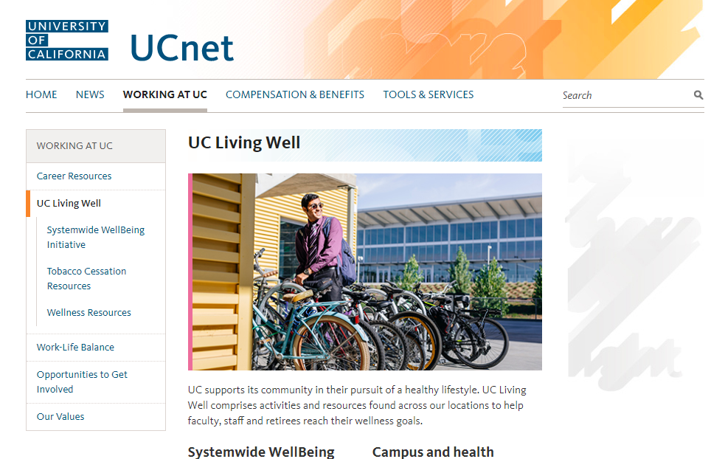
39
39
MORE HEALTH & WELFARE BENEFITS NEW EMPLOYEE BENEFITS ORIENTATION
ucal.us/uclivingwell
Notes:
UC supports faculty, staff and retirees in their pursuit of a healthy lifestyle by building a culture that values health and well-being. UC Living Well, the university’s wellness program, provides activities and resources to help faculty, staff and retirees reach their wellness goals.
Find out more on the UC Living Well website. The site has links to local wellness programs, which can differ in the types of initiatives and events offered.

Slide 40
40
40
MORE HEALTH & WELFARE BENEFITS NEW EMPLOYEE BENEFITS ORIENTATION
Additional Plans
 | Mid-Level | CORE
Auto and Homeowner/Renter | ✓
Family Care | ✓ | ✓
Notes:
UC offers you access to a number of other benefits and programs, such as these listed here. You can learn more about all of them on UCnet.
============
As a reminder, Q&A will be saved for the last portion of the presentation.
- What type of medical expenses can I use my Health FSA for? Copays, deductibles, bandaids, glasses, ….a complete list is available on UCnet.

Slide 41

41
41
ucnet.universityofcalifornia.edu
Notes:
Now, that we’ve told you about the health & welfare benefits, you probably want to know which of your dependents are eligible to be covered and how to enroll.

Slide 42
42
42
ELIGIBILITY AND ENROLLMENT NEW EMPLOYEE BENEFITS ORIENTATION
Who’s eligible?
ADULTS
CHILDREN
Spouse
Domestic partner
(regardless of gender identification or whether registered with the state)
Biological or adopted child
Stepchild, grandchild or
step-grandchild
Domestic partner’s child or grandchild
Legal ward (under 18)
Overage disabled child
Notes:
Here’s the list of adults who are eligible.
In most cases, premiums for domestic partners must be paid on an after-tax basis. If they are your California tax dependents, premiums may be deducted from your pay on a pretax basis for California income tax purposes if you have registered your partnership with the state.
And these are the children you can enroll. Some of these dependents must meet additional qualifications for benefits eligibility.
.

Slide 43

43
43
ELIGIBILITY AND ENROLLMENT NEW EMPLOYEE BENEFITS ORIENTATION
UC’s Definition of a Domestic Partnership (if not registered with the state)
Each Other’s Sole Domestic Partner in a Long-Term, Committed Relationship and Intended to Remain so Indefinitely
Neither Party Legally Married or a Partner in Another Domestic Partnership
Not Related to Each Other by Blood
Both Parties 18 Years Old and Capable of Consenting to the Relationship
Parties Financially Interdependent
Parties Share a Common Residence
Notes:
More information can be found on UCNet, Benefits for Domestic Partners

Slide 44
44
44
ELIGIBILITY AND ENROLLMENT NEW EMPLOYEE BENEFITS ORIENTATION
No Duplicate Coverage
Coverage as an employee OR as dependent of employee/retiree
Family members may not be enrolled in more than one UC employee’s plan
Includes health, life and AD&D plans
Notes:
UC rules do not allow duplicate coverage under our plans, including health, life and AD&D plans.
This means you may not be covered in UC-sponsored plans as an employee AND as an eligible family member of a UC employee or retiree at the same time.
Family members of UC employees may not be enrolled in more than one UC employee’s plan. For example, if a husband and wife both work for UC, their children cannot be covered by both parents.
Again, please refer to the Insurance Eligibility Fact Sheet for Employees available on UCnet for more details.

Slide 45
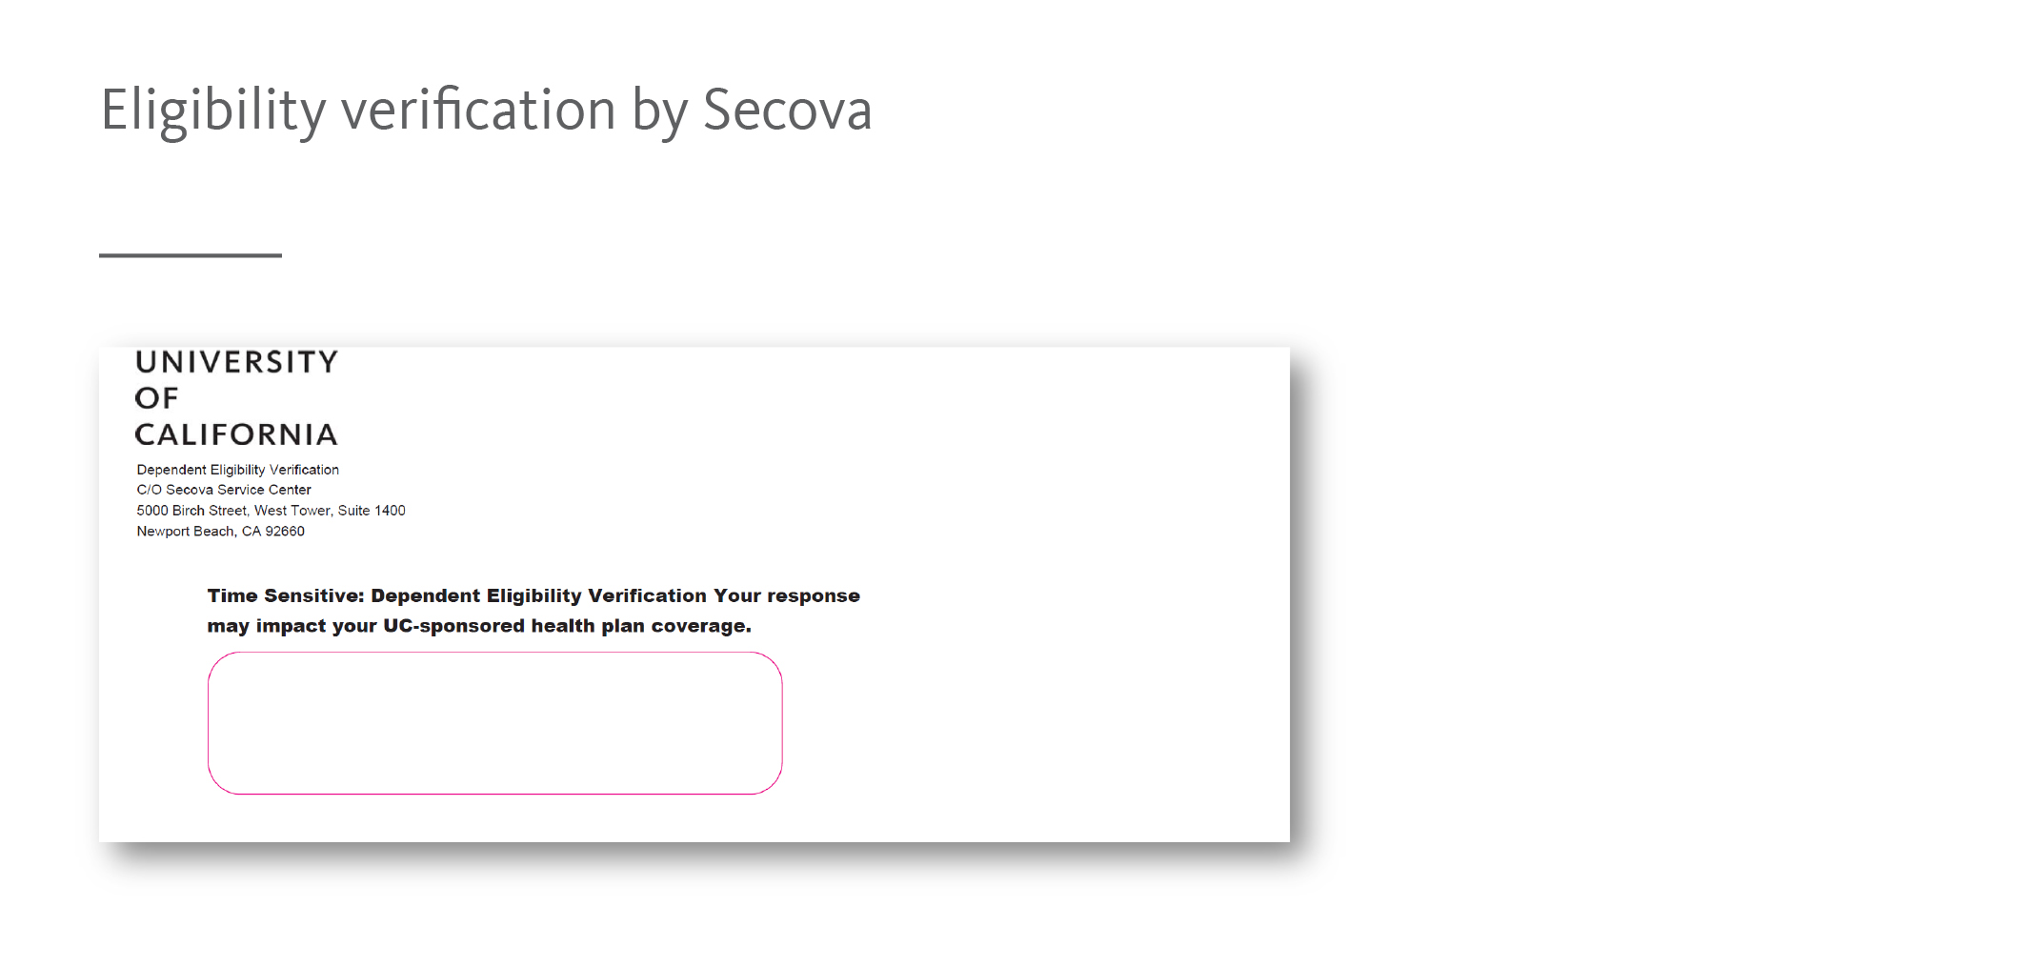
45
45
ELIGIBILITY AND ENROLLMENT NEW EMPLOYEE BENEFITS ORIENTATION
Eligibility verification by UnifyHR
Notes:
If you enroll any dependents, you will be asked to verify that they are eligible.
All new employees who enroll in UC-sponsored coverage will receive a mailing from UnifyHR to provide proof of eligibility for family members.
This is an ongoing process and applies to any change in family status (marriage, birth/adoption, etc.).
If you don’t provide the requested information, your family members will be de-enrolled from your benefits.

Slide 46
46
46
ELIGIBILITY AND ENROLLMENT NEW EMPLOYEE BENEFITS ORIENTATION
When to enroll
Period of Initial Eligibility (PIE)
31 calendar days from:
First date of eligibility
Date of hire / change in appointment
Date of birth, marriage or adoption
Involuntary loss of other group coverage
Opt-out (decline enrollment)
Default Plans
If you take no action: Basic Life, Basic short term disability , BTA only
If you miss your PIE:
90-day delayed enrollment
Medical only
With evidence of insurability
Supplemental life / dependent life
Voluntary short-term and long-term disability
Open enrollment is October - November
Effective following January
Notes:
Your period of initial eligibility or PIE is the 31 days beginning with your date of hire or other qualifying event. During this period you enroll yourself and your eligible family members in medical and any other plans for which you’re eligible.
You can decline enrollment or opt-out of plans during your PIE, Open Enrollment, or if you have a qualifying event.
If you take no action during PIE, you will be automatically enrolled in CORE life insurance, basic short term disability and business travel accident only.
If you miss the 31 day PIE, there are additional opportunities to enroll in some of the benefit plans:
For medical insurance only, you can enroll at any time by submitting the appropriate forms and coverage will become effective in 90-days.
For Supplemental and dependent life and voluntary short term and long term disability, you may submit a statement of health—also called evidence of insurability—and if the insurance company approves, you may enroll. Previous or existing medical conditions may prevent approval.
During Open Enrollment, which usually occurs in November, you can enroll in, re-enroll, or change medical and flexible spending accounts. Legal is open during this period in some years. The effective date of changes made during Open Enrollment is the following January.

Slide 47
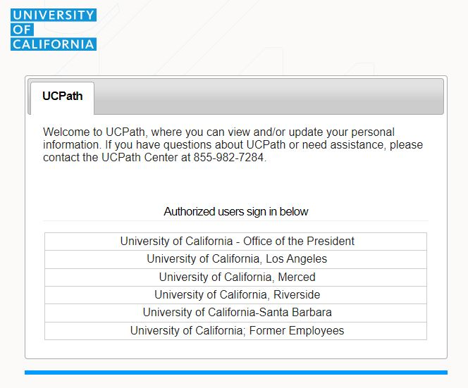
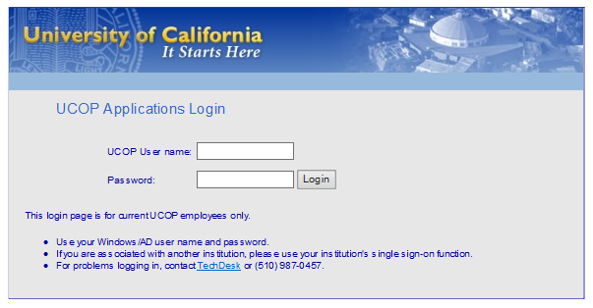
47
47
ELIGIBILITY AND ENROLLMENT NEW EMPLOYEE BENEFITS ORIENTATION
How to enroll – UCPath (ucpath.universityofcalifornia.edu)
User name and Password are the same as your network sign-on
Notes:
We’ve talked about who can enroll and when to enroll, now we will show you HOW.
You can access the UCPath portal by going to ucpath.universityofcalifornia.edu. (Click)
Clicking on your campus location will take you to the network log-in page, where you will enter your network user name and password.

Slide 48
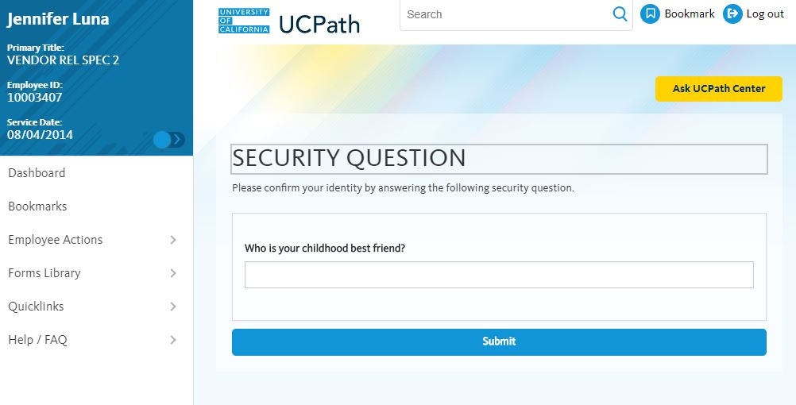
48
48
ELIGIBILITY AND ENROLLMENT NEW EMPLOYEE BENEFITS ORIENTATION
Security Verification
Notes:
UCPath has launched a new feature to further protect and verify your identity – personalized security questions and answers.
Answers must be at least four characters and are not case sensitive.
The following process only applies to the first time an employee sets up their security questions and answers.

Slide 49
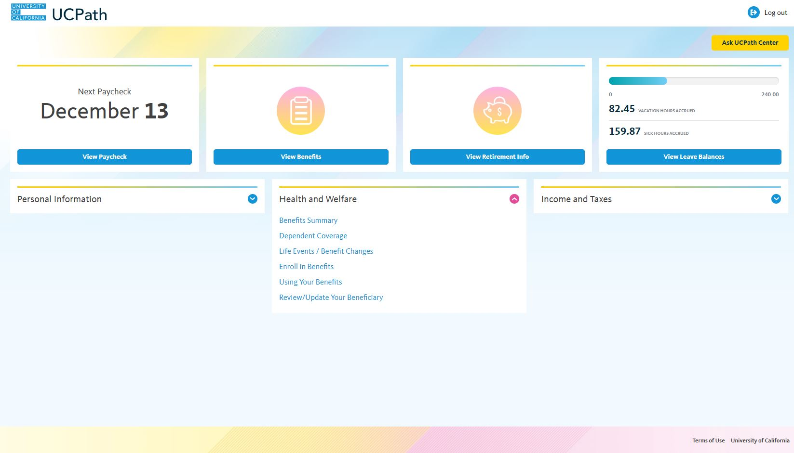
49
ELIGIBILITY AND ENROLLMENT NEW EMPLOYEE BENEFITS ORIENTATION
Notes:
Select “Enroll in benefits” in the “Health and Welfare” section and follow the instructions provided. You must complete enrollment before selecting *submit*. You are not able to partially enroll and return to complete it later.
Remember that once you hit the *submit* button, your enrollment is final. You will receive a confirmation email after you enroll.

Slide 50
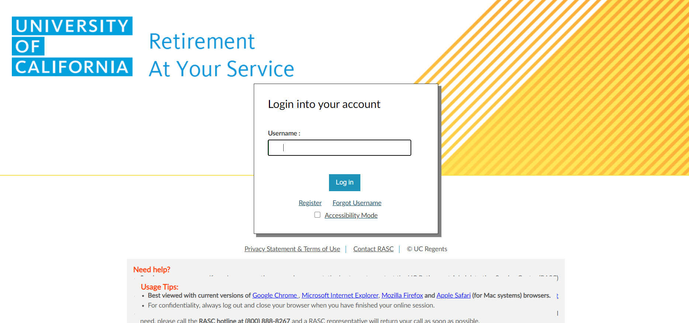
50
50
ELIGIBILITY AND ENROLLMENT NEW EMPLOYEE BENEFITS ORIENTATION
Notes:
All locations will use UC Retirement At Your Service (UCRAYS) to name your beneficiaries at “https://www.retirementatyourservice.ucop.edu”

Slide 51
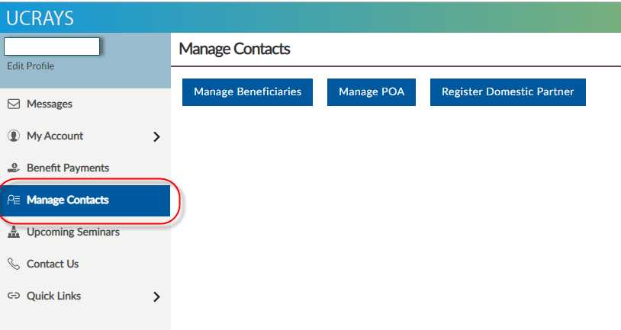
51
ELIGIBILITY AND ENROLLMENT NEW EMPLOYEE BENEFITS ORIENTATION
Notes:
To manage beneficiaries on UC Retirement At Your Service (UCRAYS):
Step 1: Log into UCRAYS
Step 2: Click on the “Manage Contacts” in the side navigation bar

Slide 52
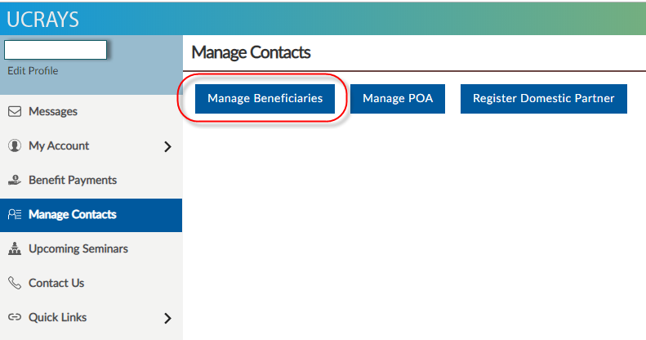
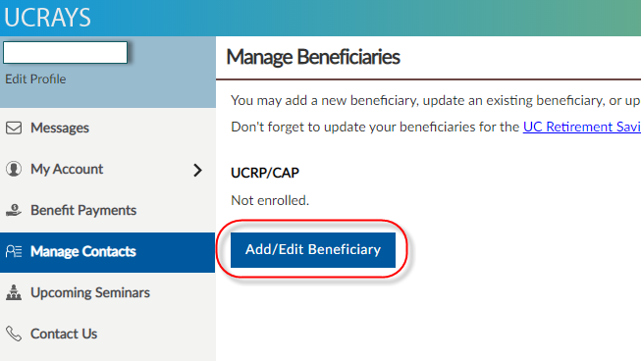
52
ELIGIBILITY AND ENROLLMENT NEW EMPLOYEE BENEFITS ORIENTATION
Notes:
Step 3: Click on “Manage Beneficiaries”
Step 4: Click on Add/Edit Beneficiary

Slide 53
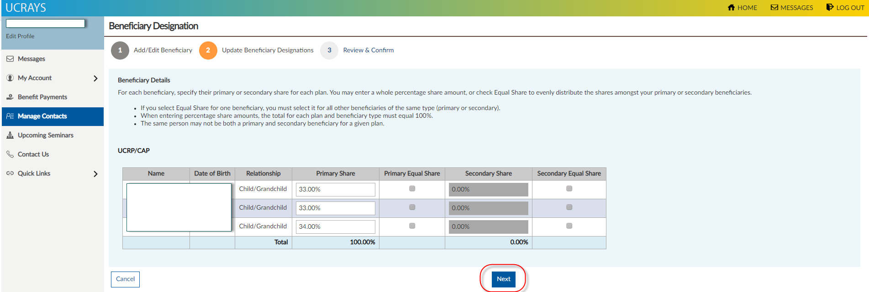
53
ELIGIBILITY AND ENROLLMENT NEW EMPLOYEE BENEFITS ORIENTATION
Notes:
Step 5: Choose the appropriate beneficiary designations.

Slide 54
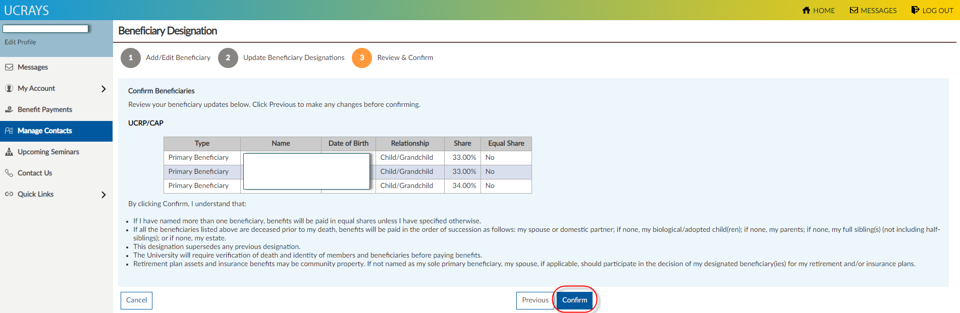
54
ELIGIBILITY AND ENROLLMENT NEW EMPLOYEE BENEFITS ORIENTATION
Notes:
Step 6: Confirm the change

Slide 55
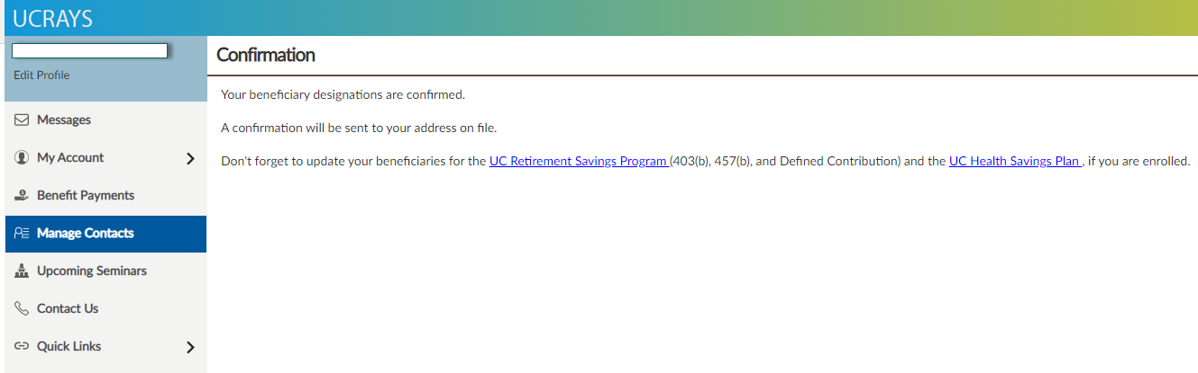
55
ELIGIBILITY AND ENROLLMENT NEW EMPLOYEE BENEFITS ORIENTATION
Notes:
Once the process is complete, you will be taken to this confirmation page.

Slide 56
56
56
ELIGIBILITY AND ENROLLMENT NEW EMPLOYEE BENEFITS ORIENTATION
When coverage begins
First day of eligibility
(IF YOU ENROLL WITHIN YOUR 31 day PIE)
First day worked
Exception: AD&D is effective the day that you enroll
Exception: Health and/or Dependent Care FSAs; effective date is first day of month following enrollment (subject to payroll deadlines)
Open Enrollment
(IN OCTOBER - NOVEMBER)
Changes effective January 1 of the following year
Only medical, FSA and ARAG (in certain years) are “open”
Notes:
If you complete your benefit plan enrollment within 31 days of your PIE, coverage is effective on your first day of eligibility. This is usually your first day at work.
Exceptions are AD&D, which is effective on the day that you enroll, and Pet Insurance which is effective the date the carrier approves your application. And, flexible spending accounts which are usually effective on the first day of the month following enrollment.
(Click)
Your next chance to make benefit changes will be during Open Enrollment in the fall, unless you have a qualifying event like marriage or birth of a child. Only medical, dental, vision, supplemental health plans, and FSA and Legal are Open.
Once you are enrolled in a medical plan through the university, that plan becomes your primary insurance even if you are covered under a spouse, domestic partner, or parent’s plan.
========================
We’ve covered your eligibility requirements and enrollment process, we also wanted to briefly discuss UC’s reconciliation policy and how it relates to your benefits. The next few slides will cover helpful information regarding this process and what to expect as a new employee.
[In case of question]
- Can I enroll my opposite sex domestic partner? Yes, if at least one of you is over age 62 and eligible to receive Social Security benefits based on age.
- Why are there these limitations if same sex domestic partners are not subject to this requirement? UC is currently studying this issue and will determine whether any changes will be made to its current regulations over the next 12 months. Additionally, coverage that is denied because the individual is not eligible to participate in the plan may be appealed, using the attached appeal procedures.

Slide 57
57
ELIGIBILITY AND ENROLLMENT NEW EMPLOYEE BENEFITS ORIENTATION
Reconciliation of Benefits Premiums
The premium reconciliation process follows premiums payment polices as set forth in the Group Insurance Regulations:
There is no charge for the first full or partial month’s coverage as a result of an Employee’s initial PIE or for the first full or partial month’s premium difference, if any, when a Family Member is first added to the plan.
Premiums for Medical Plans, Legal Services, Life Insurance, and AD&D Insurance, are paid in advance. Premiums for Disability Insurance are paid in arrears for monthly employees and at the current month for bi-weekly employees. Premiums are paid for a full month, even if coverage stops before the end of the period.
Notes:
Reconciliation of Benefits Process overview
{Click for animation and read first Bullet Slide}
{Click for animation and read second Bullet on Slide then read below}
UCPath’s reconciliation process is to collect retroactive benefit premiums due within *2-3 paychecks after the employee has completed their benefit elections. *subject to change due to payroll processing deadlines.

Slide 58

58
58
ucnet.universityofcalifornia.edu
Notes:
While your health and welfare benefits take care of you and your family now, your retirement benefits help you build a financially secure future.

Slide 59

59
59
RETIREMENT BENEFITS NEW EMPLOYEE BENEFITS ORIENTATION
Notes:
Very important details on retirement benefits for Safe Harbor employees are explained in the brown “Complete Guide to Your UC Retirement Benefits” booklet in your Welcome Kit.
You can also find a summary in “Your Guide to Understanding Your Program” available on UCnet.

Slide 60
60
60
RETIREMENT BENEFITS NEW EMPLOYEE BENEFITS ORIENTATION
Retirement Benefits – All Safe Harbor Employees
Mandatory UC Retirement Savings Program
Pre-tax Defined Contribution plan
Employees contribute 7.5%
In lieu of Social Security taxes
Optional UC Retirement Savings Program
Pre-tax 403(b) plan
Pre-tax 457(b) plan
After-tax Defined Contribution plan
Notes:
All Safe Harbor employees automatically contribute on a pre-tax basis, 7.5% of pay to the DC plan, a tax-deferred savings program. These contributions are in lieu of paying Social Security taxes.
To increase your retirement savings, you may also make voluntary contributions to the 403(b) and 457(b) plans on a pre-tax basis or to the DC plan on an after-tax basis.
Fidelity is the recordkeeper for the Retirement Savings Program and also provides customer service support.

Slide 61
61
61
RETIREMENT BENEFITS NEW EMPLOYEE BENEFITS ORIENTATION
Mandatory DC Plan
Employee contributions of 7.5% deducted before income taxes calculated
Contributions automatically invested in age-appropriate UC Pathway Fund
Can change investment elections at any time
Distribution options
Keep money in Plan
Rollover money into another employer’s plan/IRA
Have distribution paid to you
Receive retirement income
Notes:
Participants contribute 7.5% pre-tax, in lieu of Social Security tax.
Contributions are automatically invested in an age-appropriate UC Pathway Fund.
Participants may take a distribution only when you are no longer working for UC in any capacity.
If you leave UC employment, you may:
-Keep your money in the Plan
-Request a distribution to be paid to you or arrange for a direct rollover of your money to an IRA or other employer plan.
-Receive retirement income from the plan, if eligible

Slide 62
62
62
RETIREMENT BENEFITS NEW EMPLOYEE BENEFITS ORIENTATION
Voluntary Retirement Savings Program
Tax-deferred 403(b) Plan
457(b) Deferred Compensation Plan
Defined Contribution (DC) Plan
After-tax account
Notes:
In addition to your pre-tax DC contributions, UC gives you the opportunity to save for your retirement through the Retirement Savings Program. You can contribute to these plans through payroll deductions.

Slide 63
63
RETIREMENT BENEFITS NEW EMPLOYEE BENEFITS ORIENTATION
Most similar to 401(k)
403(b) and 457(b) Plans and Features
FEATURE | 403(b) | 457(b)
All employees eligible, except students working <20 hrs/week | Yes | Yes
Tax deferred contributions and earnings | Yes | Yes
Loans available | Yes | No
Hardship/emergency* | Yes | Yes
Maximum contribution $20,500 + $6,500 catchup | Yes | Yes
Distribution while employed at UC | Age 59 ½ | Age 59 ½
Distribution after separation (with no early distribution penalty) | Age 59 ½ | No age requirement
* Different terms apply to 403(b) and 457(b)
Notes:
Let’s start by looking at the 403(b) and 457(b) plans. Because these plans are very similar, we like to present them together. Remember, the 403(b) plan is most similar to a 401(k) plan.
Who can participate? Everyone, except students who generally work less than 20 hours/week.
You can make contributions on a pretax basis, which means contributions are made before taxes are taken from your paycheck, reducing your taxable income now. You pay taxes on the contributions and earnings later, when you withdraw funds from the plan.
Loans are only available under the 403(b) plan.
Both plans offer withdrawals for Hardship and Emergency situations, but the rules differ between the Plans and we suggest you refer to Fidelity and the plan booklet for more details.
The IRS code limits the amount participants can contribute annually, and the amount is currently based on if you are under the age of 50, or age 50 and older. These amounts are revisited each year and are therefore subject to change.
Also, you can contribute to both plans and double your annual retirement savings.
Another key difference is when you can take out your money without penalty. While you are working at UC, you can take it out at age 59 ½ for the 403 and 457 plans. After you’ve left UC, you can take it out at age 59 ½ for the 403 and any age for the 457.

Slide 64
64
64
RETIREMENT BENEFITS NEW EMPLOYEE BENEFITS ORIENTATION
Defined Contribution - 401(a)
After-tax account
Voluntary contributions
Different from a Roth plan
Notes:
The defined contribution or 401(a) plan allows participants to contribute on an “after-tax” basis via payroll deduction into the After-Tax account.
Although the contributions are after-tax, the earnings remain fully tax-deferred until withdrawn later. Note this is not the same as a Roth plan. The biggest difference being Roth plans have a lot more restrictions because the earnings in a Roth are not taxed.

Slide 65
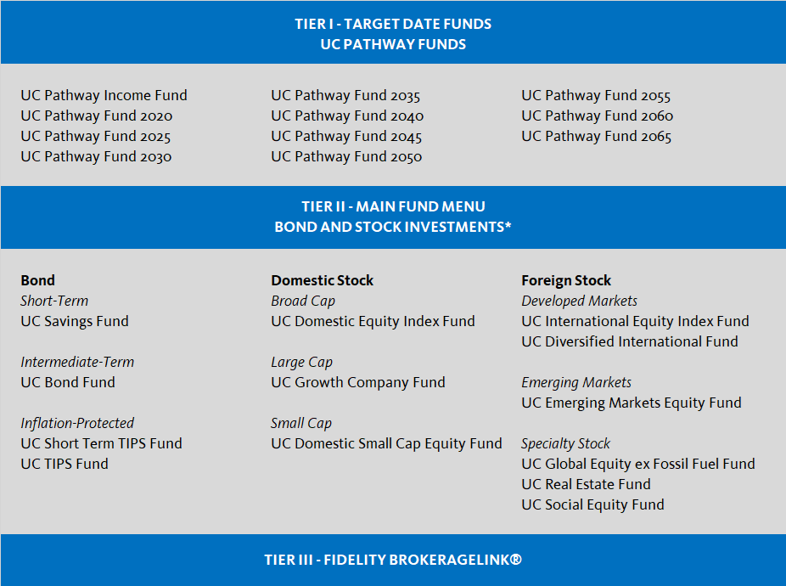
65
65
RETIREMENT BENEFITS NEW EMPLOYEE BENEFITS ORIENTATION
Investment Options
UC Pathway Funds
Direct Investment Funds
Range of asset classes
BrokerageLink
A self-directed brokerage account
Notes:
Aside from contributions, the compounding of investment earnings is how savings can grow over time.
The investment fund menu offers participants a comprehensive, yet manageable range of investment options with varying objectives and degrees of risk.
One of the options is the UC Pathway Funds, which is a set of funds managed to adjust risk level as each approaches a target date. They are designed for investors who want a simple, yet diversified approach to saving for retirement.
There are also direct investment funds, in a range of asset classes on the menu.
If you want more choice beyond what is on our menu, you can access about 5000 additional funds through BrokerageLink. These will have retail expense ratios, which are higher than what is charged to the UC funds.
If you don’t choose any funds, your contributions will automatically be invested in the UC Pathway Fund with the target date closest to the year you turn 65.

Slide 66
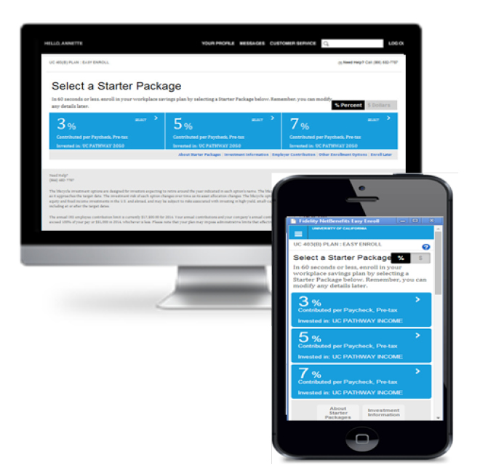
66
66
RETIREMENT BENEFITS NEW EMPLOYEE BENEFITS ORIENTATION
Voluntary Retirement Savings Program – How to enroll
Call Fidelity at (866) 682-7787 or go to netbenefits.com
Select plan type, monthly contribution amount (% or flat dollar), investments
Easy Enroll at UCRSPenroll.com
Simplified enrollment online or on a smartphone
UC Pathway Fund
Choose to contribute 5, 7 or 9% of salary
Notes:
After you’ve picked the plan, this is how you enroll.
You can call Fidelity to enroll over the phone or do it online.
There’s a link to netbenefits from the Ucnet home page. Once you’re on netbenefits, you can select the plan, the contribution amount—either a percent of your income or a flat dollar amount—and the investments.
If you are still in uncertain about which plan to pick, but want to get started, you might consider the Easy Enroll tool.
It’s a fast and easy tool that offers just a few choices to get you enrolled quickly. You just pick whether you want to contribute 5, 7 or 9% of your monthly pay. You will be enrolled in the 403(b) plan and your contributions will be invested in an age appropriate UC Pathway Fund. You can make changes to these elections at any time.

Slide 67
67
67
RETIREMENT BENEFITS NEW EMPLOYEE BENEFITS ORIENTATION
Election changes & rollovers
Start, change or stop contributions any time
Roll over money from other employer-sponsored plans or IRAs
Notes:
There is also flexibility with these Plans, as you can choose to start, change, cancel, and restart one’s contribution elections at anytime, subject to payroll and systems cut-off dates.
Your election will not necessarily effect your upcoming paycheck. In general, 403b deductions will apply to your next paycheck and 457b deductions will be deducted at least one month following.
Many people want to consolidate funds from prior employer accounts. You can do that, but there are some restrictions about the type of account source and where it can go. We want to make it easy for you to do this. So contact a Fidelity customer service rep who will walk you through the process.

Slide 68
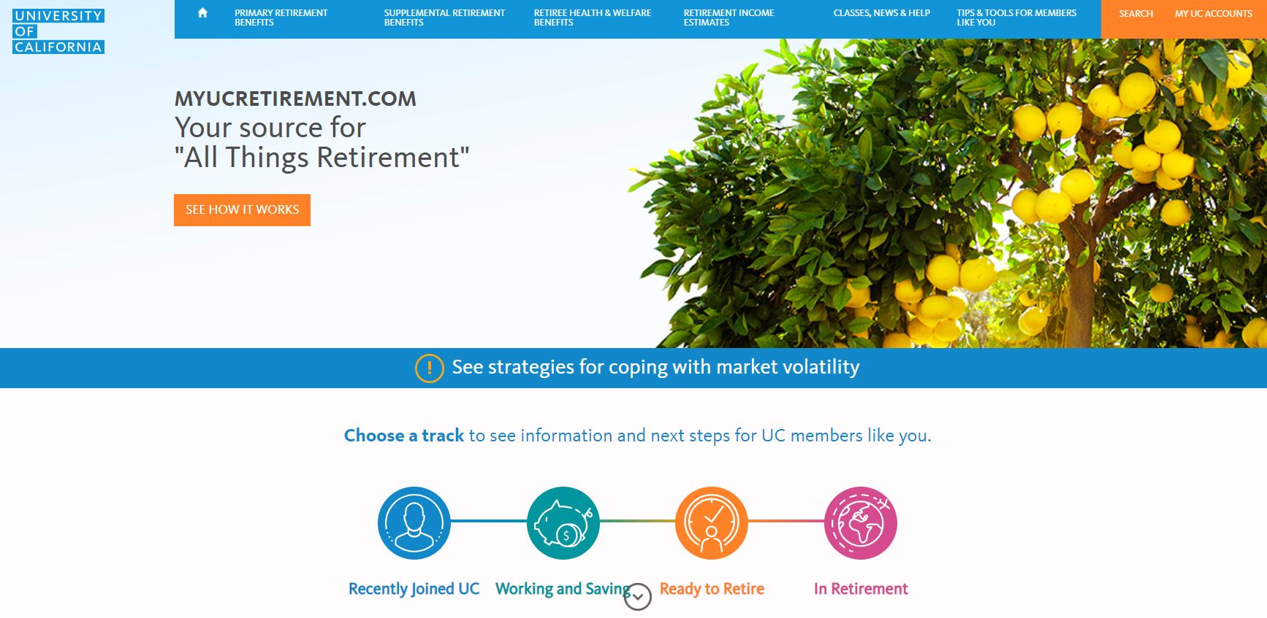
68
68
RETIREMENT BENEFITS NEW EMPLOYEE BENEFITS ORIENTATION
Want to learn more?
Online resources
On-site classes
Webinars
1:1 with UC-dedicated Workplace Financial Consultant
myUCretirement.com
Notes:
We know there’s a lot to consider, so we have tools and resources to help you make sense of it all.
There are plenty of resources available if you are interested in learning more about the Retirement Savings Program or just how to manage your personal financial situation. Visit myUCretirement.com and UCnet for more information.
================
The next section is the conclusion. Are there any questions on UC Retirement benefits ?
-Does UC have a 401k? As a public organization, we do not have a 401k plan. However, we do offer a 403(b) plan, which has comparable features.
-Which is better 403b or 457b? We outlined some of the key differences between the plans, but it really depends on your personal situation and preferences.

Slide 69

69

Slide 70
70
70
CONCLUSION NEW EMPLOYEE BENEFITS ORIENTATION
Final Reminders
Enroll in Health & Welfare benefits within your 31-day PIE
“Submit/Confirm” is final
Name your beneficiaries
Life insurance, AD&D on UCRAYS
Retirement Savings Program accounts —netbenefits.com
Health Savings Account — Health Equity
Can be changed at any time
Family Member Eligibility Verification – UnifyHR
Review your pay stub
Notes:
(Click)
Once you decide what you want to do, go to the UCPath Portal, to enroll in health & welfare benefits.
(Click)
You have exactly 31 days starting with your first day of work to enroll in health & welfare benefits. So, it’s important to get started right away.
(Click)
Remember that once you hit the *submit or confirm* button in the enrollment system, the election can not be changed.
(Click)
Don’t forget to name your beneficiaries. It’s important!
Use UCRAYS for life insurance and AD&D
You must name beneficiaries separately for the Retirement Savings Program beneficiaries on netbenefits.com and
If you enroll in the Health Savings Plan, you’ll want to name beneficiaries for your HSA through Health Equity.
Beneficiary designations do not automatically carry over across your benefits, so please make sure that you take the necessary steps to assign them for each benefit. Any of your beneficiaries can be changed at any time.
(Click)
Also, make sure you complete the materials you receive from UnifyHR requesting eligibility verification of your enrolled dependents. If you do not comply within the required timeframe, your dependents will be de-enrolled.
(Click)
Review your Online Earnings Statement (check stub) each pay day to ensure your benefit elections are correctly listed.
For COVID-19 relief, please visit Ucnet for more information.

Slide 71
71
71
CONCLUSION NEW EMPLOYEE BENEFITS ORIENTATION
Tools and Resources
Welcome Kit
UCnet
Medical plan directories
myUCretirement.com
UCPath Portal/AYSO
ALEX
https://go.myalex.com/uc/2022
UCPath center
855-9-UCPATH
UCPath.universityofcalifornia.edu
Local benefits office
Health Care Facilitators
ucnet.universityofcalifornia.edu
Notes:
We covered a lot today, so don’t worry if you can’t remember it all. You can find all of the information presented AND MORE in these tools and resources:
You should start with the materials in your Welcome Kit and then go to UCnet. UCnet will have links to specific information like medical plan provider directories, videos, plan chooser tools, and myUCretirement.
Ucnet also has contact information for the UCPath Center, local benefits offices, and health care facilitators in case you want to speak with someone about your questions.
Now we have about ___ minutes for any additional questions.

Slide 72

72
72
Notes:
At the end of the questions:
You will be receiving a survey to your work email (or the email you logged in the webinar with) regarding this presentation. Please complete this survey and be sure to add additional comments/feedback. This information will help us improve our webinar.
Thanks for joining us today.
UC is an amazing institution, and a great place to work and grow.
We’re glad you’re a part of it.

Slide 73

72
73

Slide 74
NOTICE REGARDING ADMINISTRATION OF BENEFITS
By authority of the Regents, University of California Human Resources, located in Oakland, administers all benefit plans in accordance with applicable plan documents and regulations, custodial agreements, University of California Group Insurance Regulations, group insurance contracts, and state and federal laws. No person is authorized to provide benefits information not contained in these source documents, and information not contained in these source documents cannot be relied upon as having been authorized by the Regents. Source documents are available for inspection upon request (800-888-8267). What is written here does not constitute a guarantee of plan coverage or benefits—particular rules and eligibility requirements must be met before benefits can be received. The University of California intends to continue the benefits described here indefinitely; however, the benefits of all employees, retirees, and plan beneficiaries are subject to change or termination at the time of contract renewal or at any other time by the University or other governing authorities. The University also reserves the right to determine new premiums, employer contributions and monthly costs at any time. Health and welfare benefits are not accrued or vested benefit entitlements. UC’s contribution toward the monthly cost of the coverage is determined by UC and may change or stop altogether, and may be affected by the state of California’s annual budget appropriation. If you belong to an exclusively represented bargaining unit, some of your benefits may differ from the ones described here. For more information, employees should contact their Human Resources Office and retirees should call the Retirement Administration Service Center (800-888-8267).

